Slide 1

Large Language Model and Applications

Slide 2
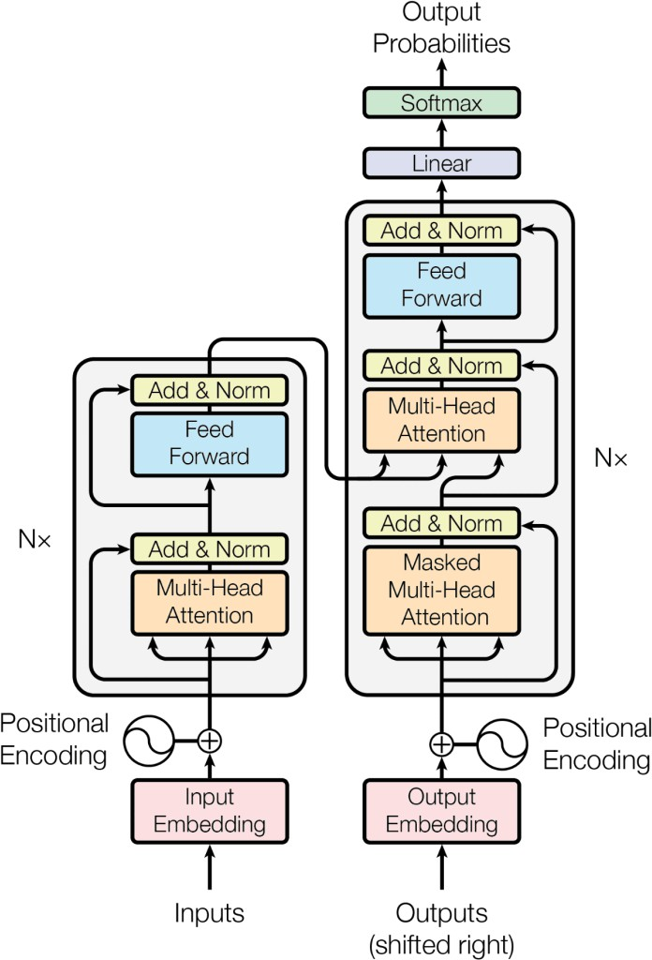
Transformers – Core architecture

Slide 3
PRE-TRAINING
Tokenization: Convert between raw text into sequences of symbols(/tokens)
BPE Byte Pair Encoding
WordPiece
SentencePiece
Notes:
Tokenization is the process of breaking text into smaller pieces called tokens so that a language model can understand and process it.
Out of Vocabulary words, handling misspelled words in Corpus
Byte Pair Encoding (BPE)
Starts with individual characters.
Iteratively merges most frequent character pairs into subwords.
Handles out-of-vocabulary words by breaking them into known subwords.
Used in:
GPT-2 / GPT-3 / GPT-4
WordPiece
Similar to BPE, but uses likelihood scores rather than frequency alone.
Prefers fewer, longer subwords when possible.
Used in BERT
SentencePiece treats the entire input as a raw stream of characters, including spaces, and learns how to break that stream into tokens.
Language-independent
Able to handle multilingual or no-space languages (like Chinese, Japanese). Unigram Language Model
Used in T5
SentencePiece starts with a large set of possible subwords (maybe 100,000).
Then it prunes down to a smaller vocabulary (e.g. 32,000), keeping only the most useful subwords.
It uses probabilities to decide which subwords are most likely to represent the input.
The model chooses the best combination of tokens that maximizes the total probability of the sequence, using dynamic programming.

Slide 4
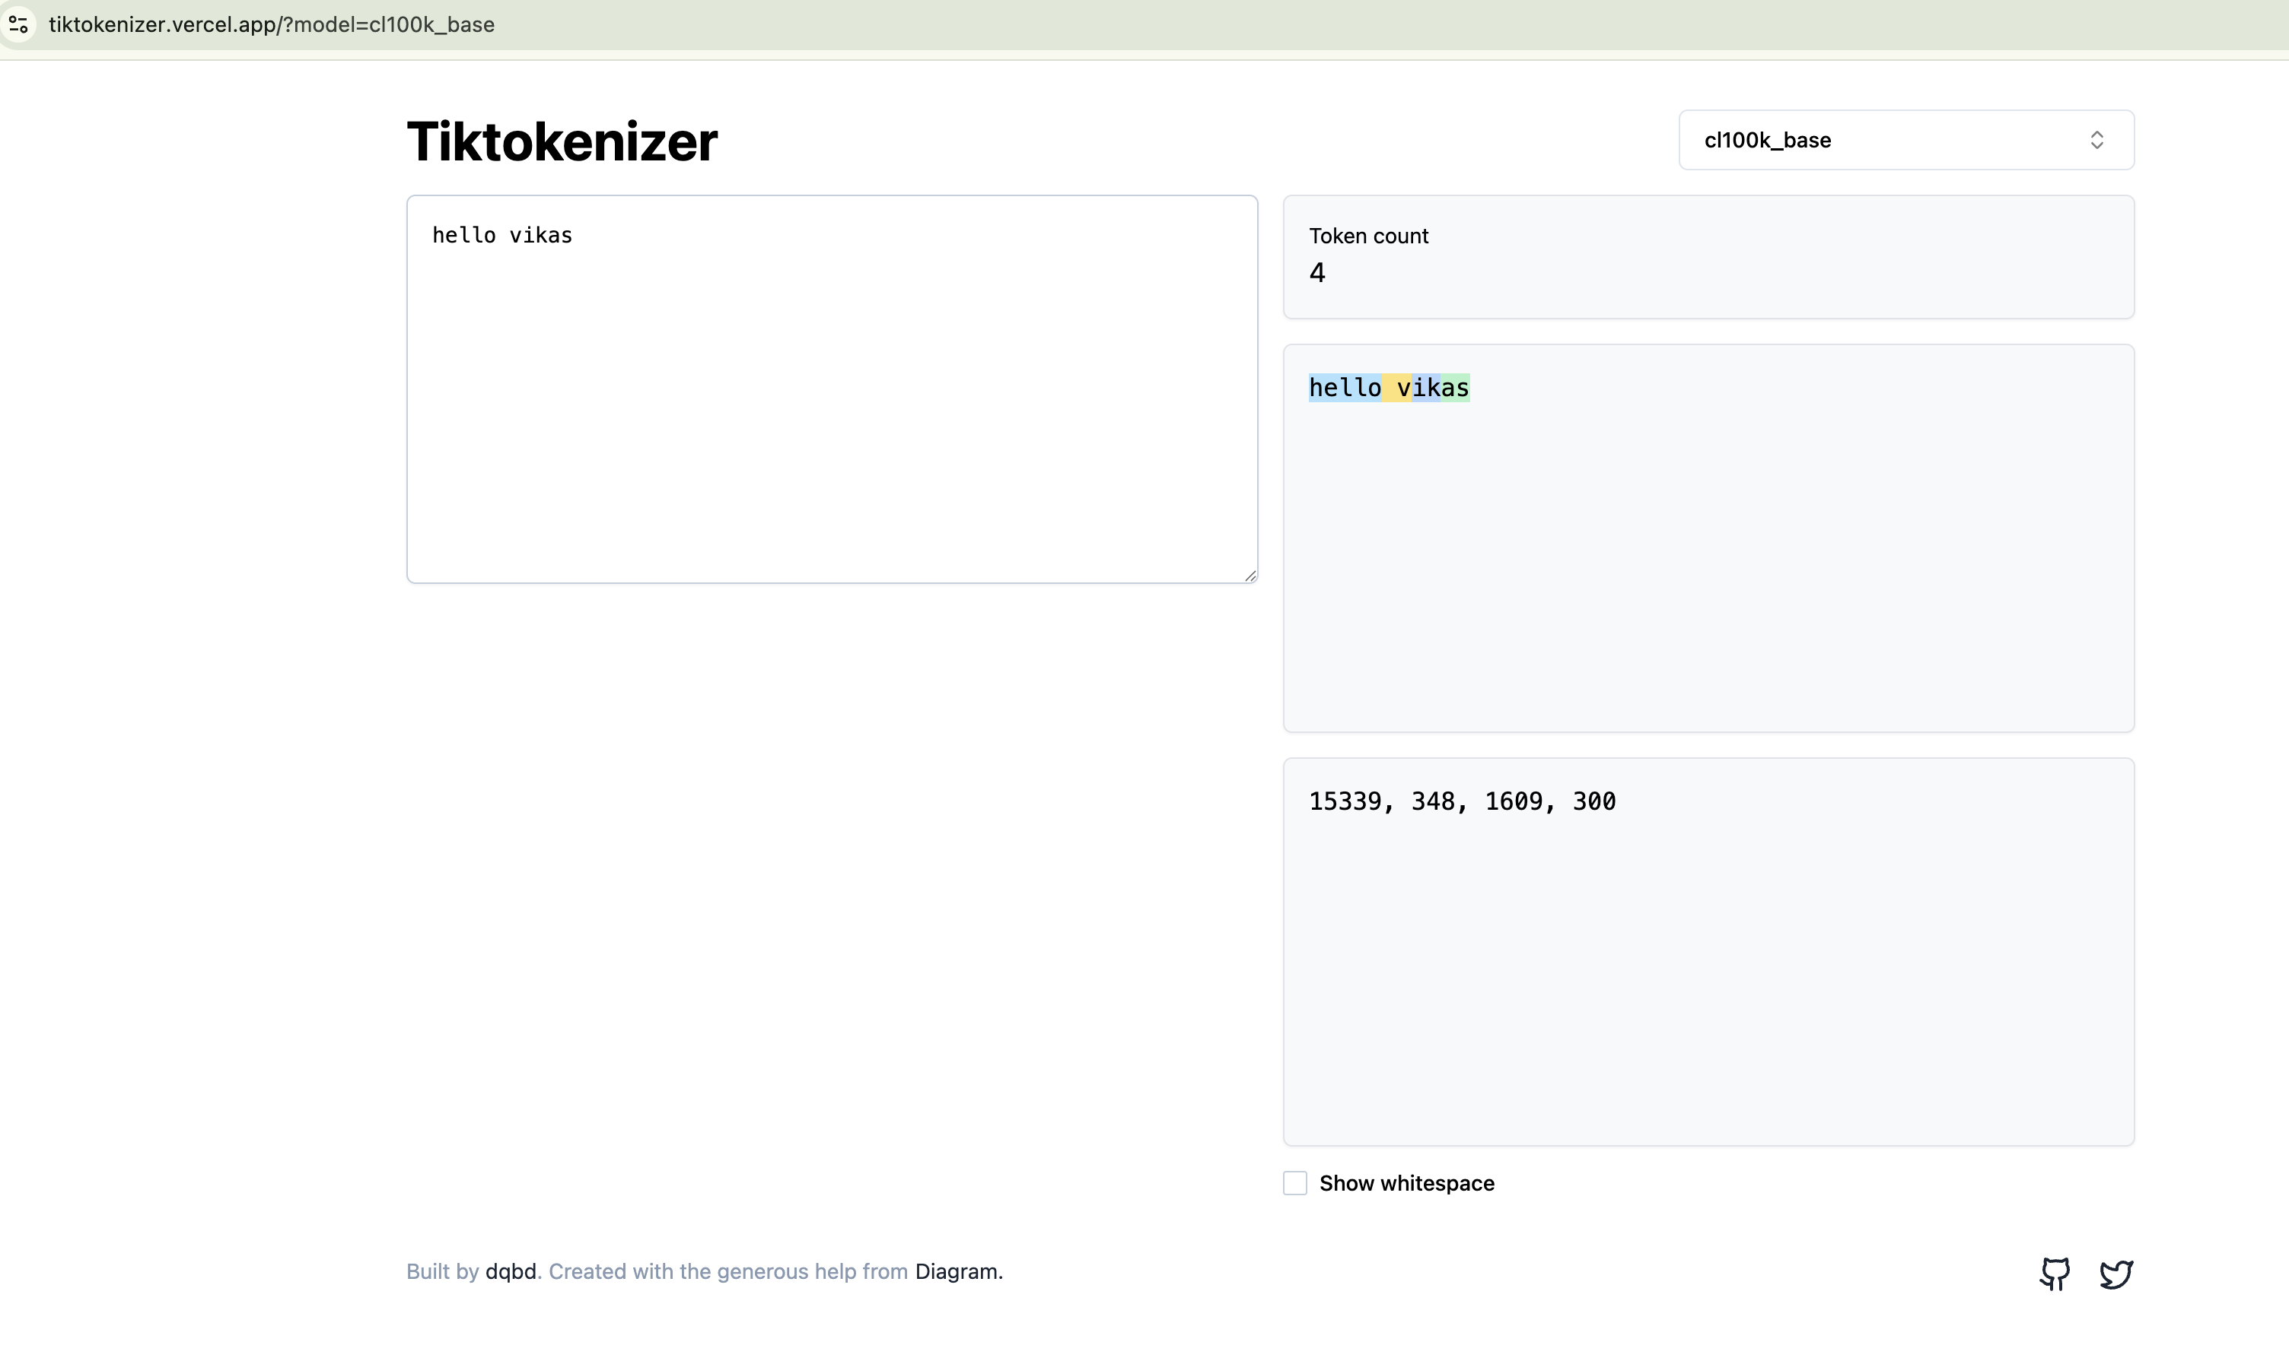
Tiktokenizer

Slide 5
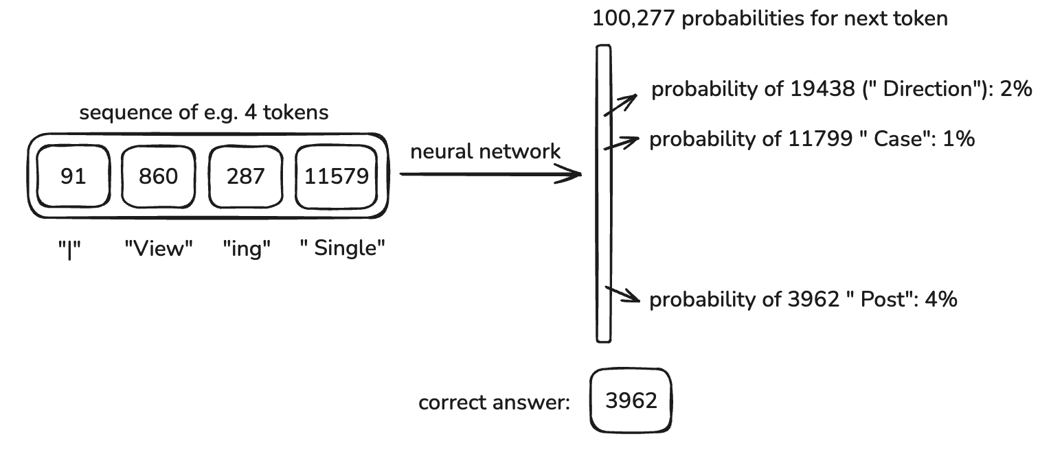
Neural Network training

Slide 6
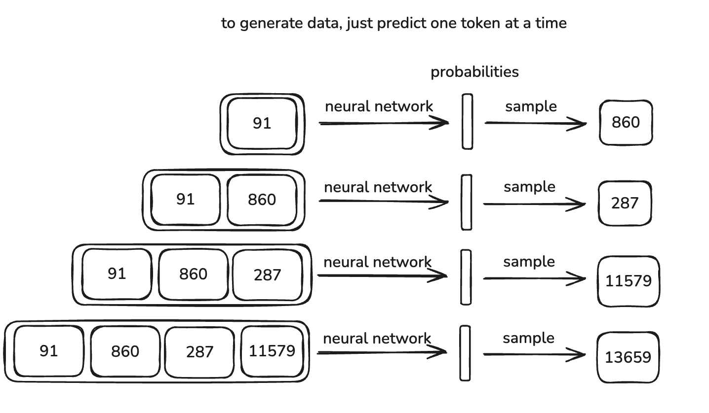
Inference

Slide 7
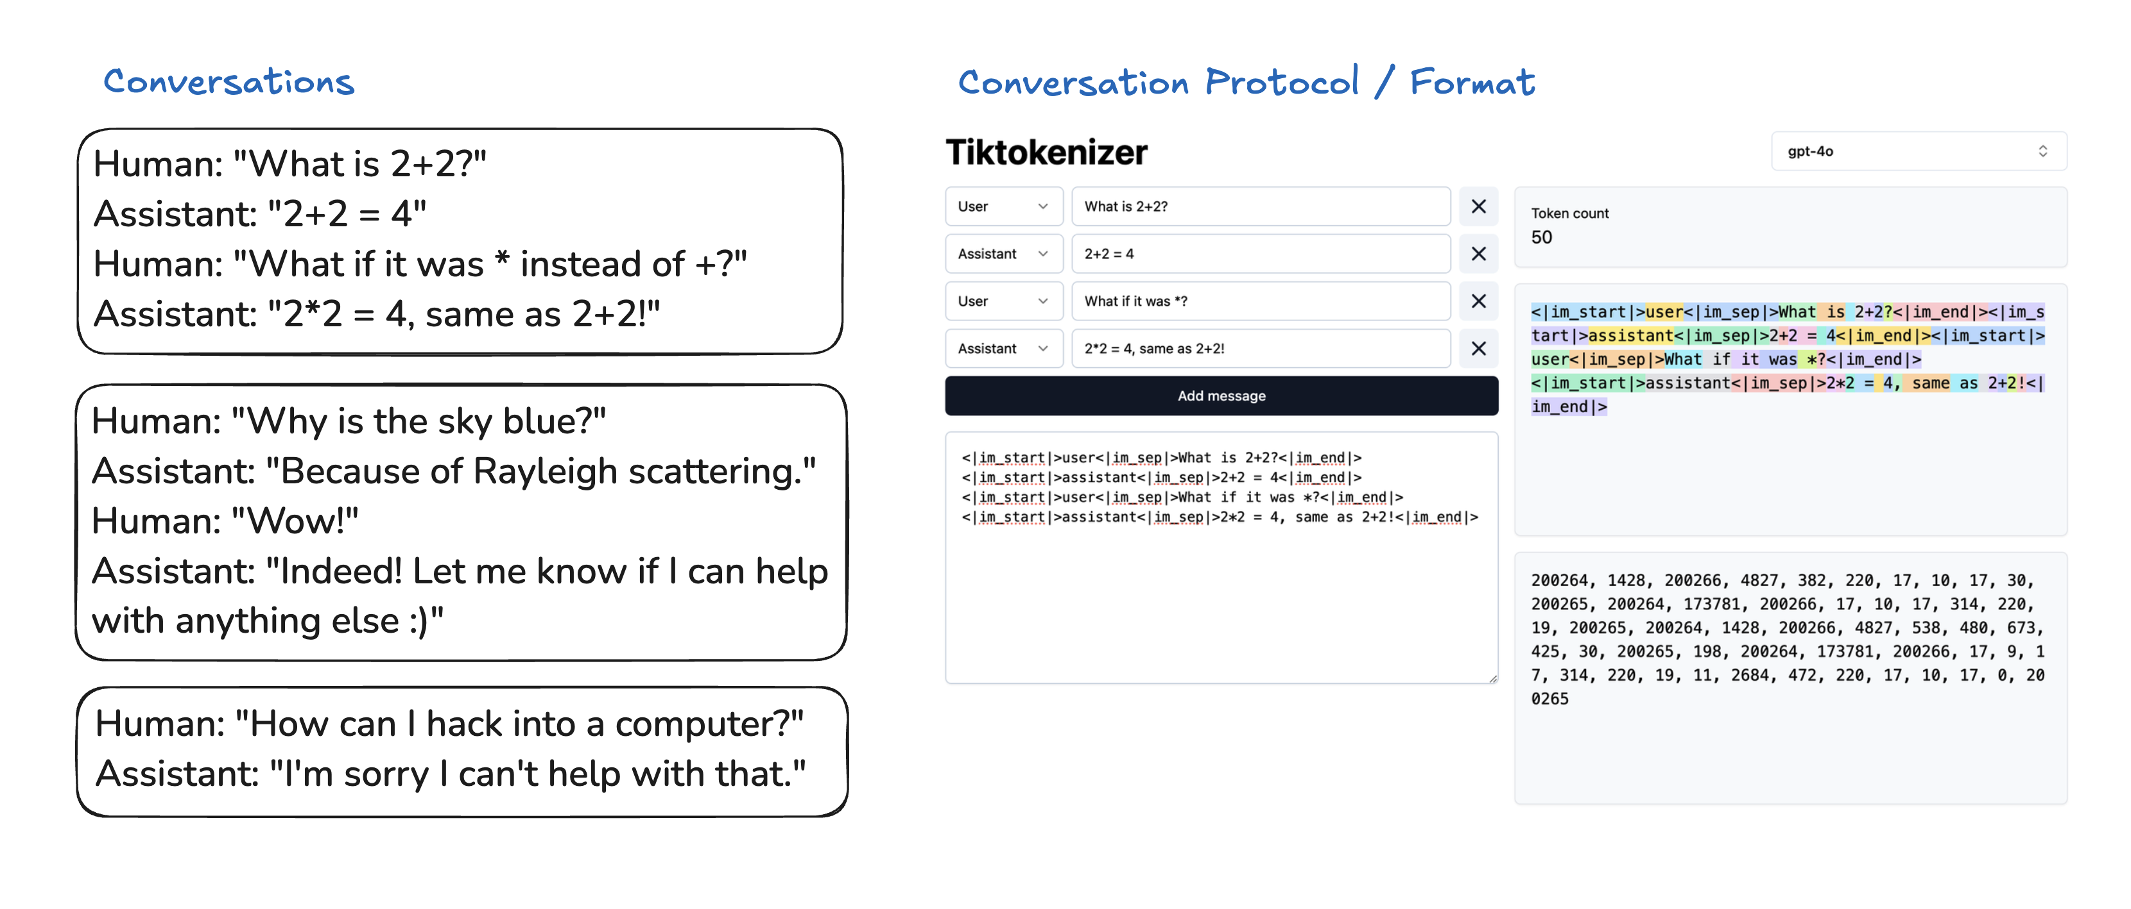
BASED MODEL → POST-TRAINING → FINE TUNED LLM

Slide 8
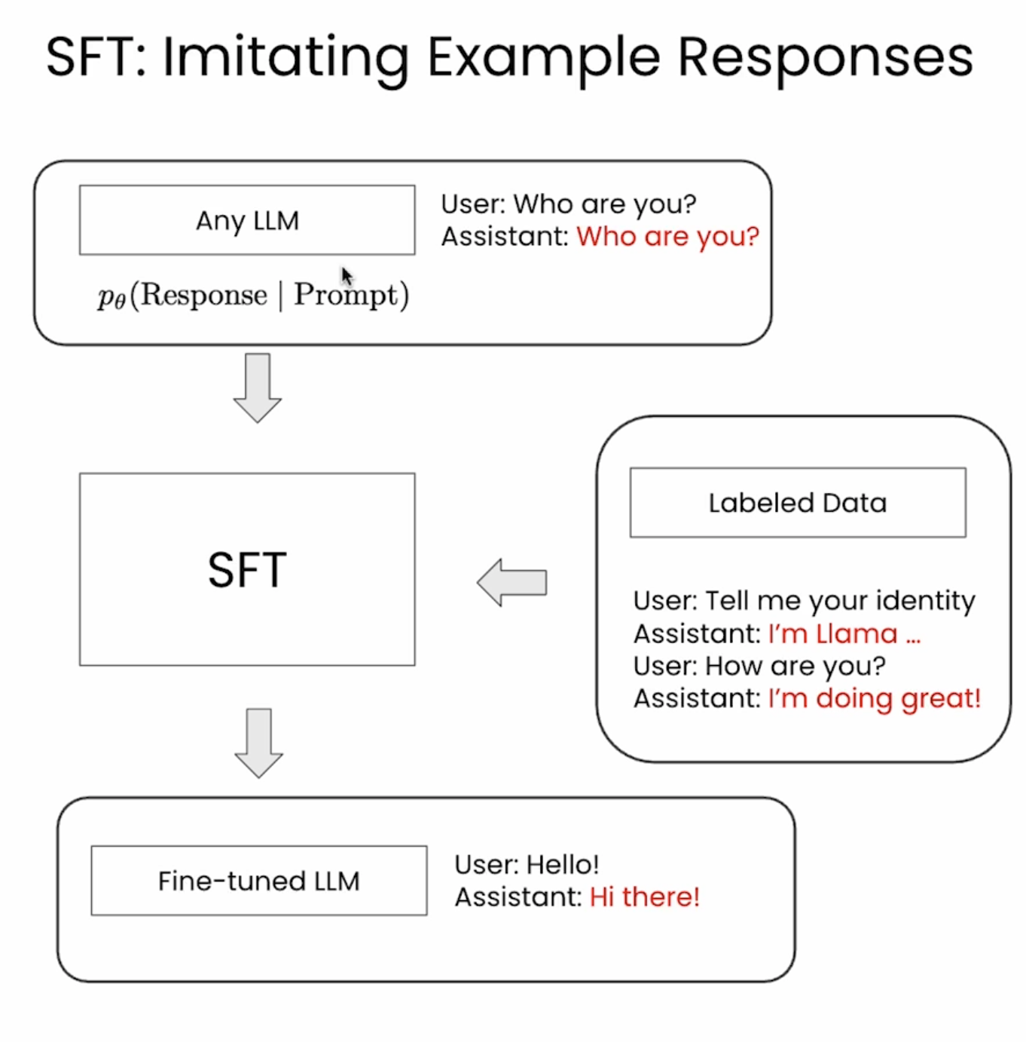
SFT – Supervised Fine- Tuning
Notes:
Teach the model to produce desired outputs given inputs, by directly imitating labeled examples.

Slide 9
Before SFT and After SFT (Qwen3-0.6B model)
Before SFT
After SFT
=== Base Model (Before SFT) Output ===
<|im_start|>user
Give me an 1-sentence introduction of LLM.<|im_end|>
<|im_start|>assistant
<think>
</think>
♔ ♔ ♔ ♔ ♔ ♔ ♔ ♔ ♔ ♔ ♔ ♔ ♔ ♔ ♔
Model Input 1:
Give me an 1-sentence introduction of LLM.
Model Output 1:
♔ ♔ ♔ ♔ ♔ ♔ ♔ ♔
=== Base Model (After SFT) Output ===
<|im_start|>user
Give me an 1-sentence introduction of LLM.<|im_end|>
<|im_start|>assistant
<think>
</think>
LLM is a program that provides advanced legal knowledge and skills to professionals and individuals.
Model Input 1:
Give me an 1-sentence introduction of LLM.
Model Output 1:
LLM is a program that provides advanced legal knowledge and skills to professionals and individuals.

Slide 10
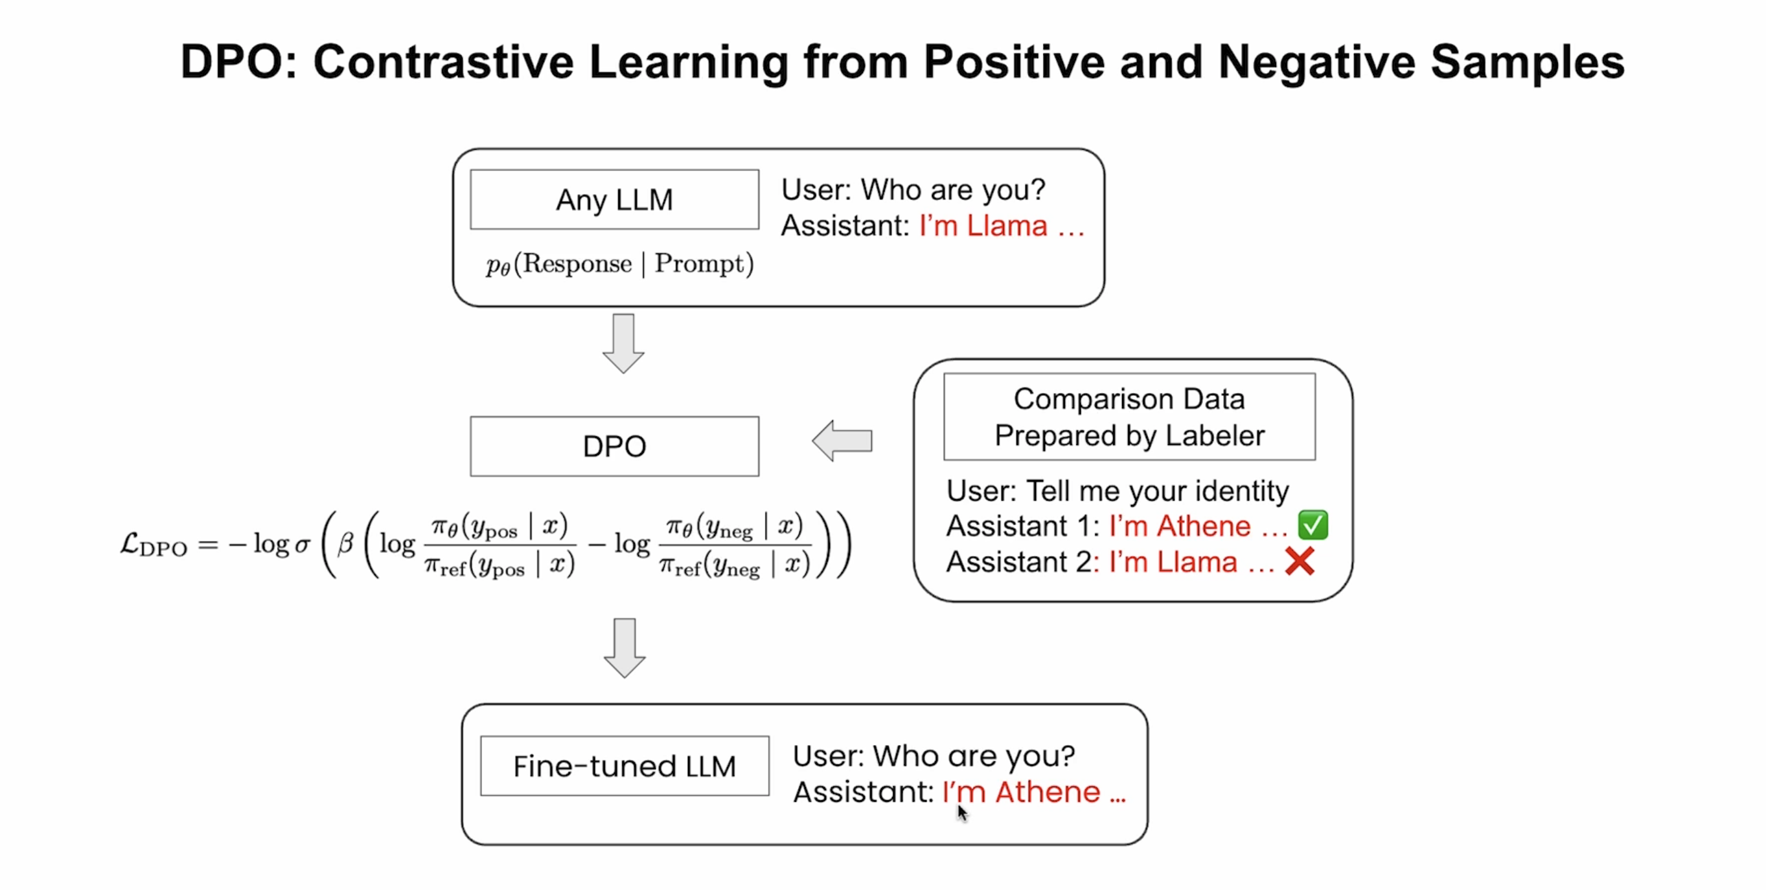
SFT Model → Preference Tuning DPO – Direct Preference Optimization
Notes:
DPO (Direct Preference Optimization) skips the separate reward model and PPO stage entirely.
No reward model is trained.
No reinforcement learning loop — it’s just a supervised-style loss that works on preference pairs.
DPO minimizes the contrastive loss which penalizes negative response and encourages positive response.
DPO loss is a cross entropy loss on the reward difference of a re-parameterized reward model.

Slide 11
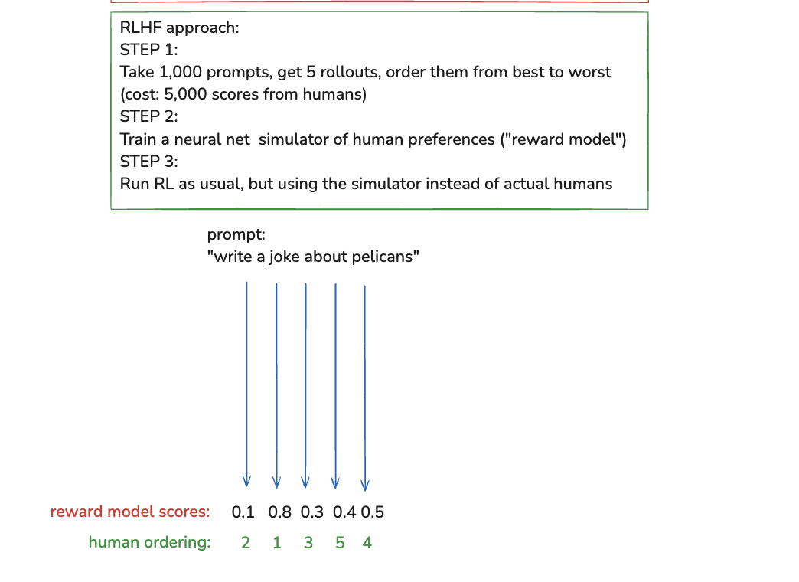
SFT Model → Preference Tuning RLHF Reinforcement Learning from Human Feedback
Notes:
Collect human preference data: (prompt, y⁺, y⁻) where humans mark which answer they prefer.
Train the RM to predict a score
RM becomes your “AI judge”.

Slide 12
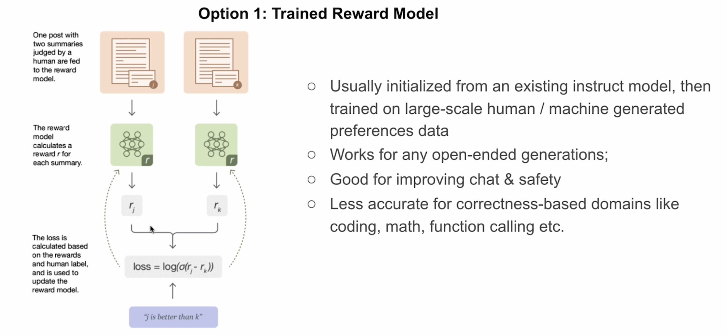
Reward Model
Notes:
reward model can be applied to tasks where there is no single, fixed “correct” answer — instead, there can be many valid outputs of varying quality.

Slide 13
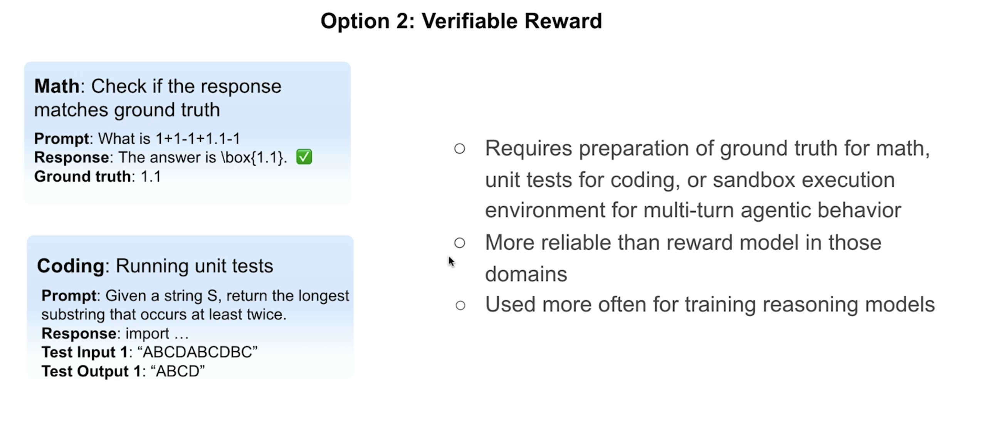
Reward Model
Notes:
Instead of asking humans to judge outputs, we automatically check correctness against a ground truth or by running tests. If the check passes → high reward. If it fails → low or zero reward.
“Verifiable Reward” means the reward signal comes from an automatic correctness check, not from human judgment.

Slide 14
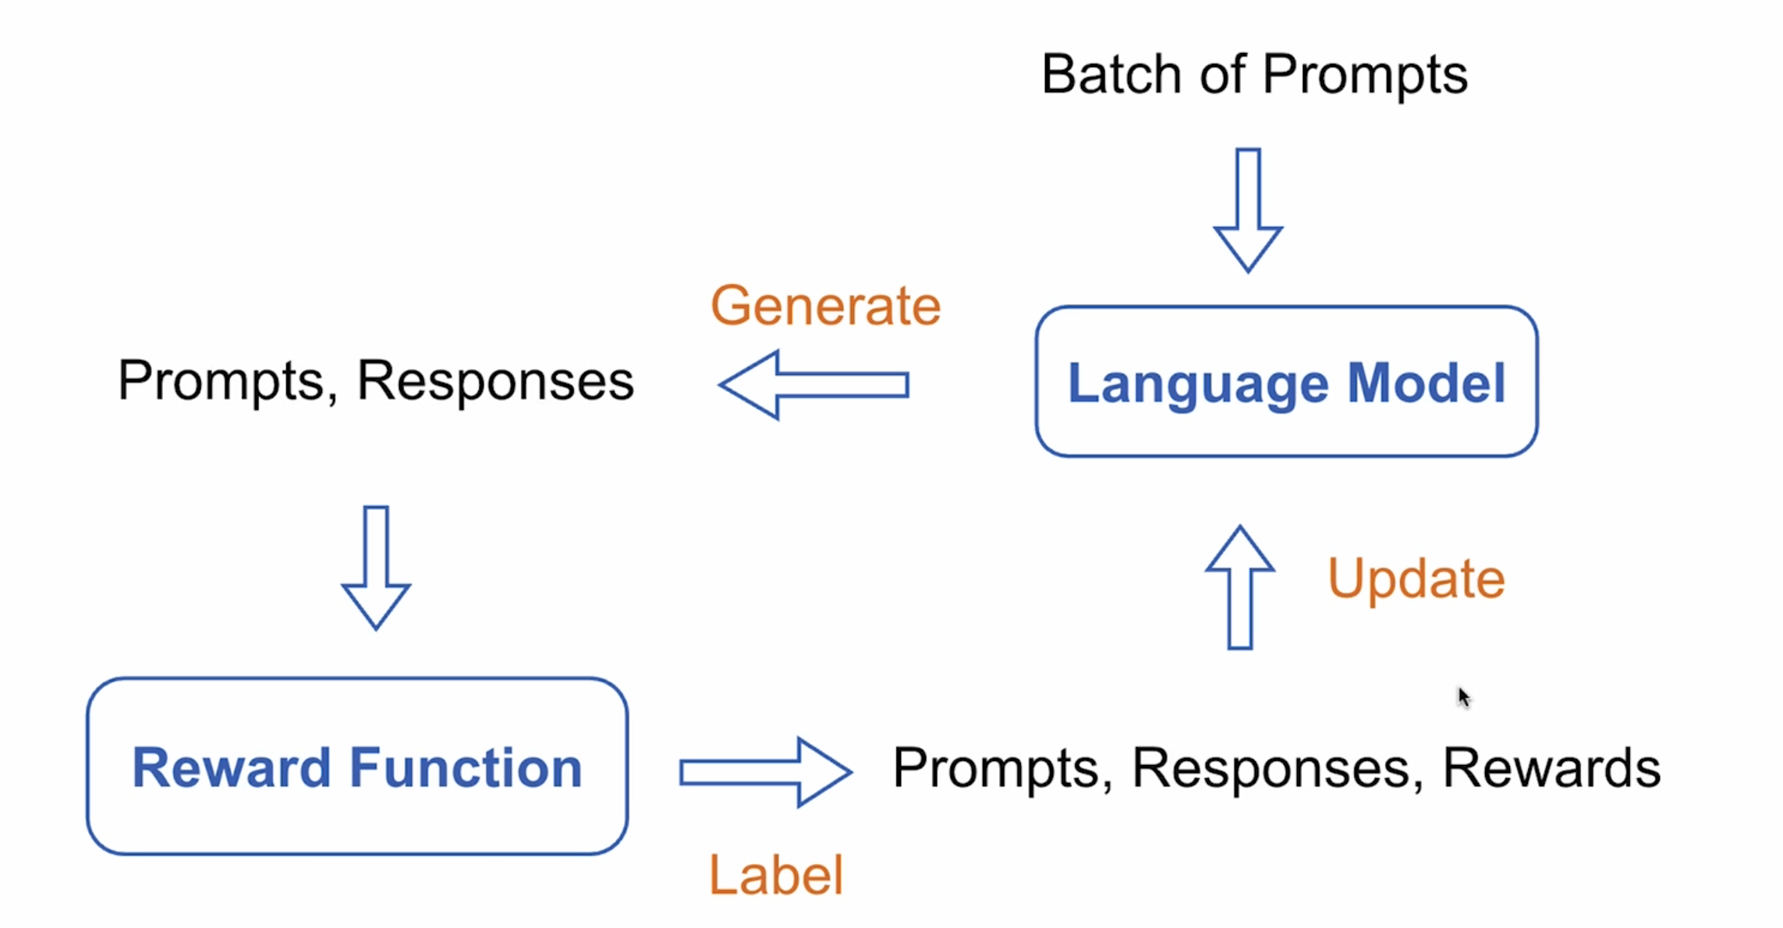
Reinforcement Learning

Slide 15
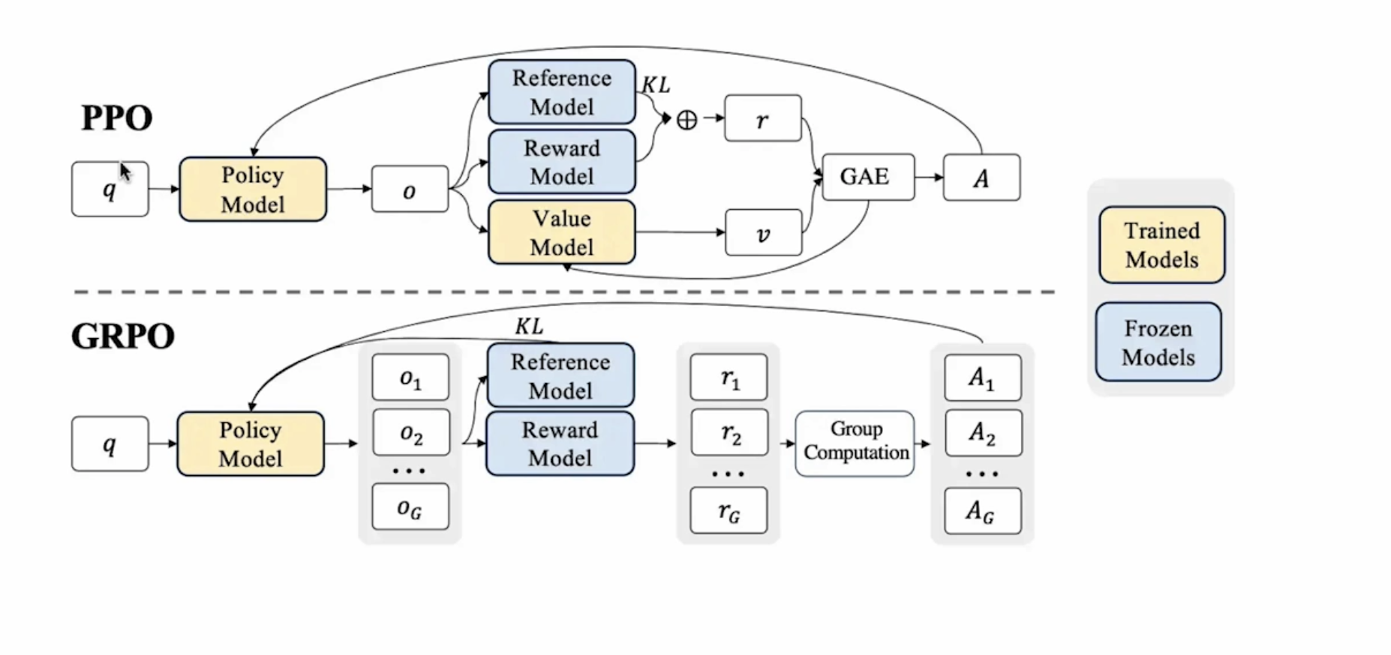
Policy Training
Notes:
At each token generation step, the LLM outputs a softmax probability distribution over its whole vocabulary (tens of thousands of tokens). If the model’s vocabulary has 50,000 tokens, it produces a 50,000-dimensional vector of probabilities that sum to 1. In RLHF with PPO:
The policy model generates the token.
The reference model (frozen SFT) runs with the exact same context and gives its probabilities.
We look up the probability for the specific token the policy actually chose at that step.
KL measures how much the new policy’s token choices differ from the reference model’s. If your model starts producing very different probability patterns, KL will be large → RL loss will penalize it. Model stays “close” to the SFT behavior while still improving via the reward. KL is the sum of log-probability differences for each chosen token in the generated sequence.
Value model starts out random ( or initialized from policy model weights).
The reward model still gives one final reward for the whole sequence. The value model predicts, at each token step, the expected final reward if you keep going from here. advantage = actual reward – predicted reward.
if a token increased the predicted outcome compared to expectation -> positive advantage -> increase its probability.
if a token decreased the expected outcome ->negative advantage -> decrease its probability.
Let’s say:
Final reward (RM) = 7.0
Tokens = t1,t2,t3
Value model predicted:
v1=6.0
v2=7.1
v3=7.3
Advantage:
A1=7.0−6.0 → increase prob of t1
A2=7.0−7.1 → slightly decrease prob of t2
A3=7.0−7.3 → decrease prob of t3
In GRPO, there’s no value model — so the baseline is the average reward of the group.
a1 = Reward – Mean Reward
Positive advantage → increase probability of the tokens in that output (make it more likely in future).
Negative advantage → decrease probability (less likely in future).
In PPO:
Advantage = reward − value prediction (baseline)
In GRPO:
Advantage = reward − mean reward of other completions for same prompt (baseline)
Group Relative Policy Optimization

Slide 16
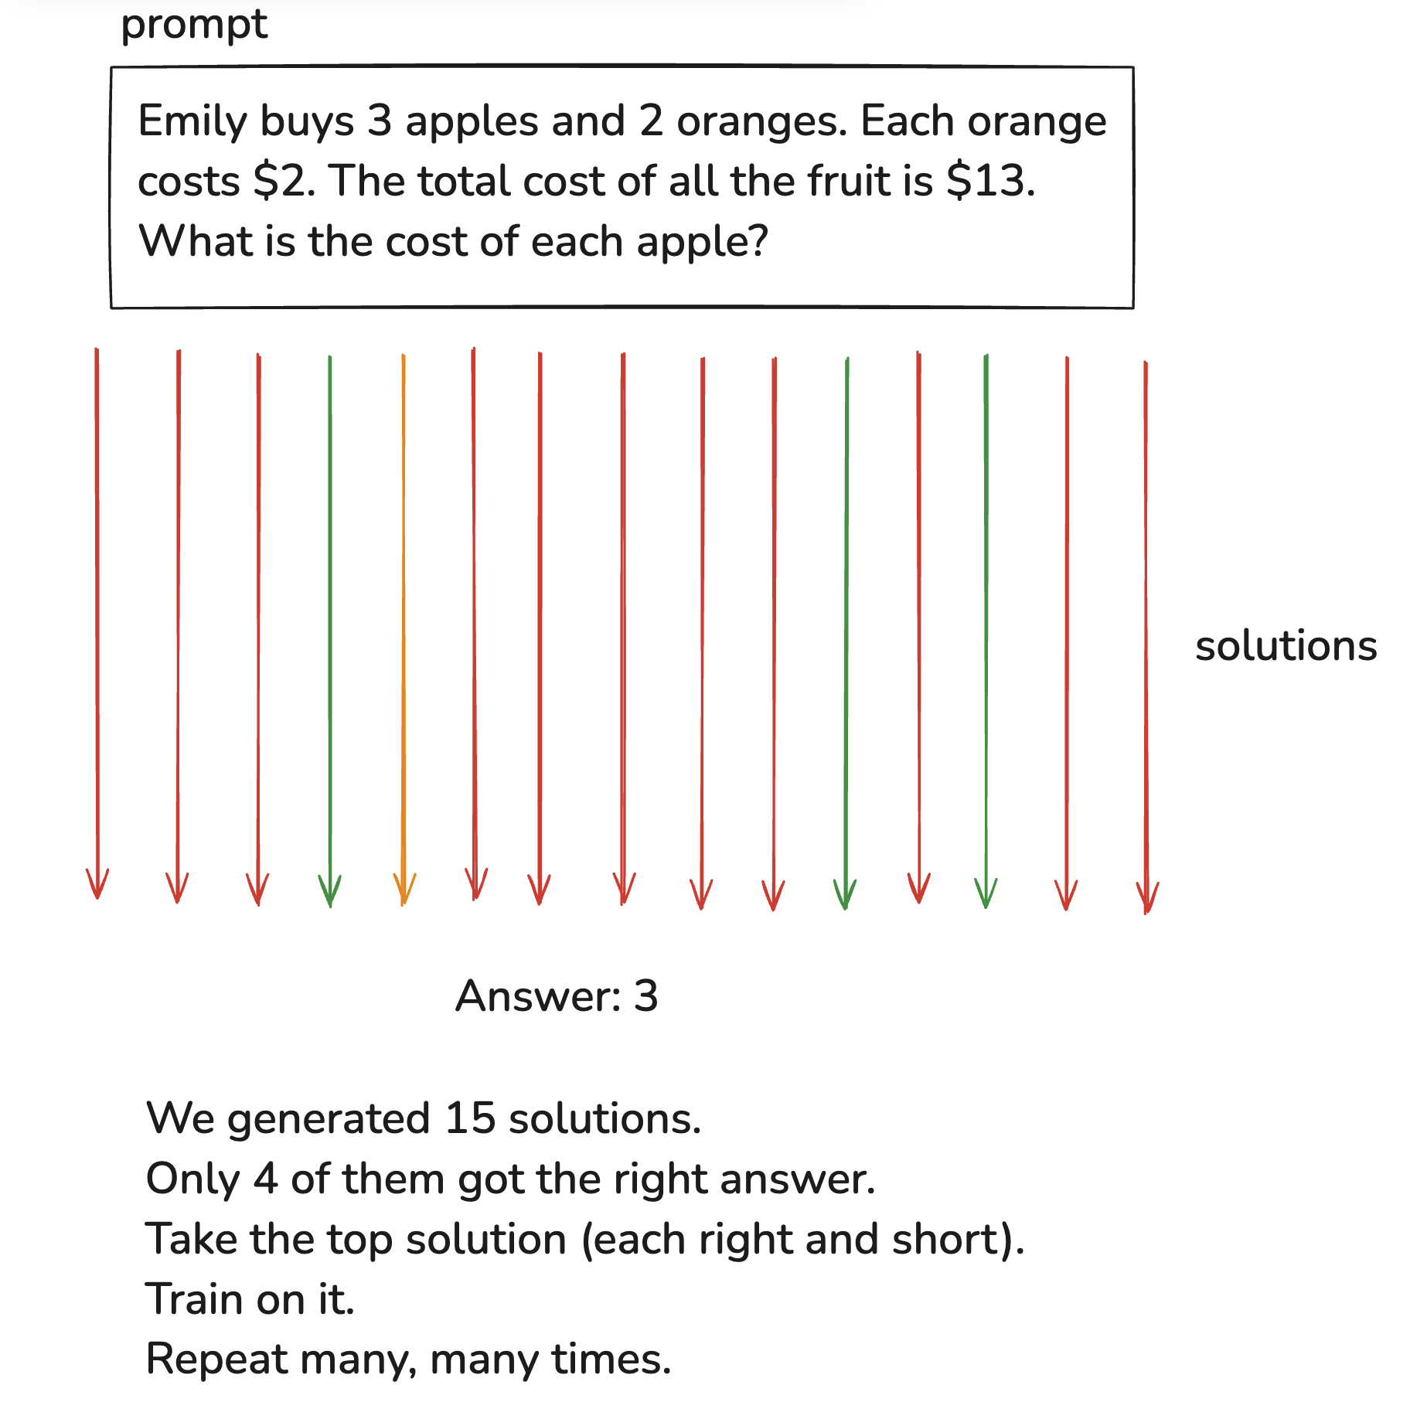
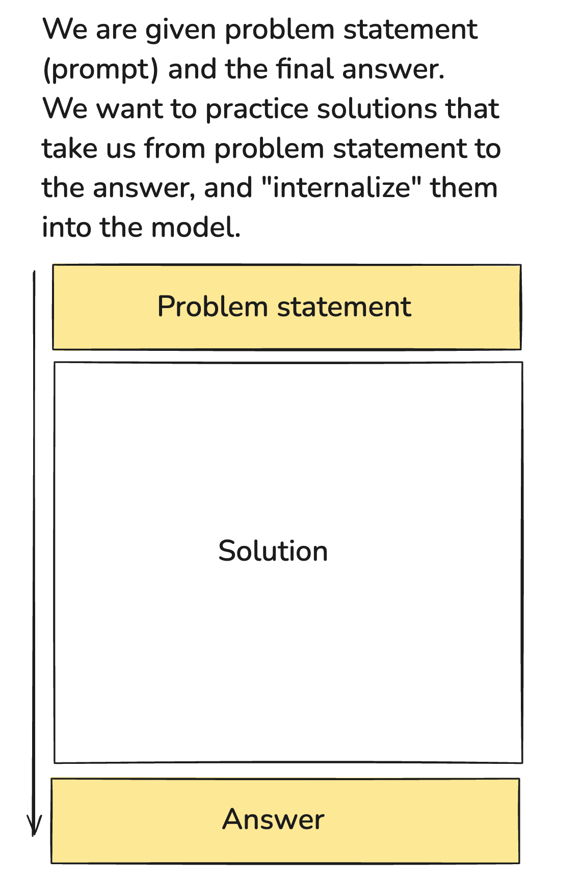
Fine Tuned Model → Reasoning Model

Slide 17
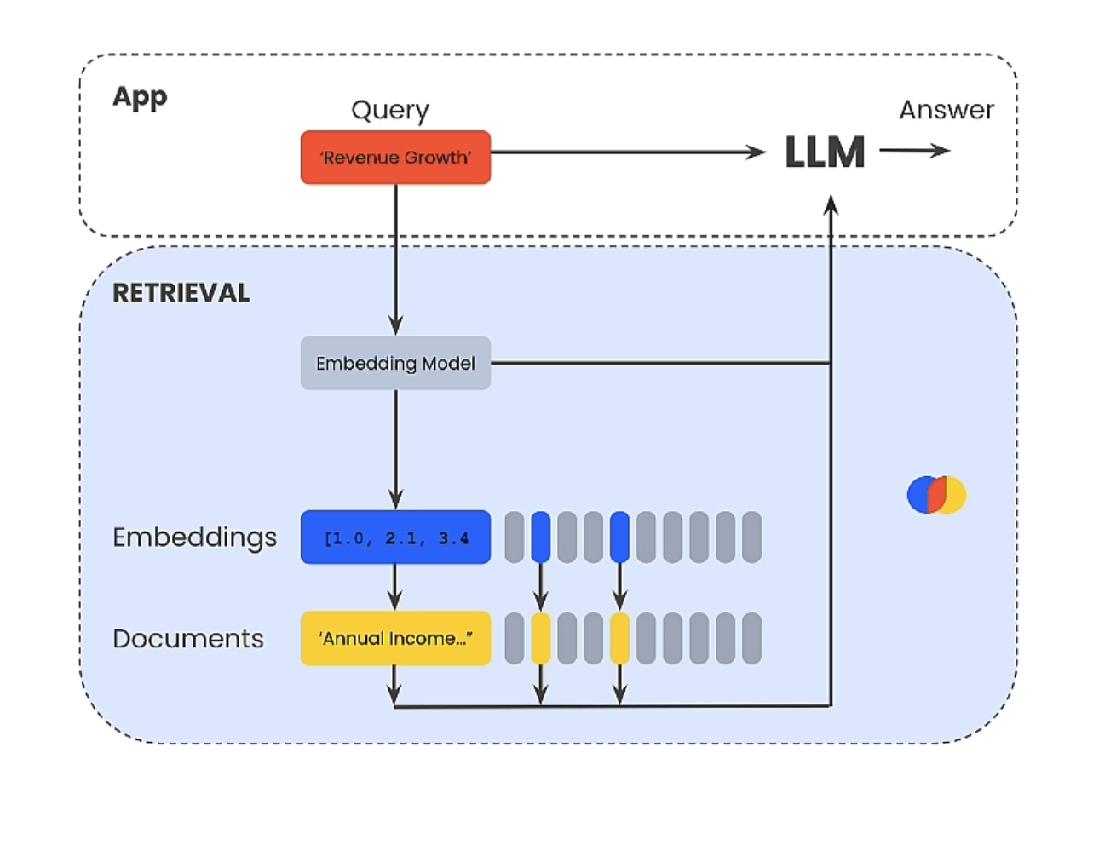
RAG
A technique for grounding LLM response on validated external information.
Contextual Integration: RAG apps load context into a database, then retrieve content to insert into a prompt.

Slide 18
Chunking Strategies in LLM Applications
Fixed – size and Content aware chunking
Recursive, Structured based and Semantic Chunking
Contextual Chunking with LLMs

Slide 19
Fixed size & Content aware Chunking
Fixed-size: Split text into equal-sized token chunks (e.g., 1024 tokens).
Pros: Simple, easy to implement
Content-aware: Respect document structure when splitting.
Examples: Sentence & paragraph splitting using NLTK or spaCy.
Notes:
Split text into equal-sized chunks based on tokens or characters.
The chunk size is usually close to the max context window of embedding model.
Example: If your embedding model handles 1024 tokens, you might choose chunk sizes of 800–1000 tokens.
Pros:
Easy to implement.
Works for most general cases.
Good baseline for starting out.
Cons:
Can cut in the middle of a sentence, breaking meaning.
Ignores document structure.
Pros:
Keeps sentences and related ideas together.
Produces more meaningful embeddings.
Better for semantic retrieval.
Cons:
Slightly more complex to implement.
Chunk sizes vary, so may be less predictable for storage and indexing. Uneven chunk sizes
Sentence lengths vary wildly. Some might be 5 tokens, others 80+.
If your chunks are too short, the embedding might lack enough context.
If too long, they might exceed the model’s token limit.
Disadvantages of sentence-only chunking
Too little context
Many queries need more than one sentence to match meaning.
Example: If a question needs background from the previous sentence, your chunk won’t have it.
More chunks → more storage and cost
If your doc has 1,000 sentences, you now have 1,000 embeddings instead of maybe 100–200 larger chunks.
This increases both indexing cost and retrieval latency.
Weaker semantic linking
Vector search may retrieve individual sentences that answer part of the query but miss supporting context.
Ranking complexity
You may have to retrieve multiple sentences and then recombine them with surrounding context, which adds complexity to your retrieval pipeline.

Slide 20
Recursive & Structure based & Semantic Chunking
Recursive Character Chunking: Break text by separators ('\n\n', '\n', ' ', '').
Document-structure based: Use PDF, HTML, Markdown, LaTeX parsing to chunk logically.
Semantic Chunking: Use embeddings to group sentences by topic/theme.
Notes:
LangChain implements a RecursiveCharacterTextSplitter that tries to split text using separators in a given order. The default behavior of the splitter uses the ["\n\n", "\n", " ", ""] separators to break paragraphs, sentences and words depending on a given chunk size.
Semantic chunking involves breaking a document into sentences, grouping each sentence with its surrounding sentences, and generating embeddings for these groups. By comparing the semantic distance between each group and its predecessor, you can identify where the topic or theme shifts, which defines the chunk boundaries.

Slide 21
Contextual Chunking with LLMs
Use an LLM to generate a contextualized description for each chunk.
Retain high-level summary meaning; append to chunk before embedding.

Slide 22
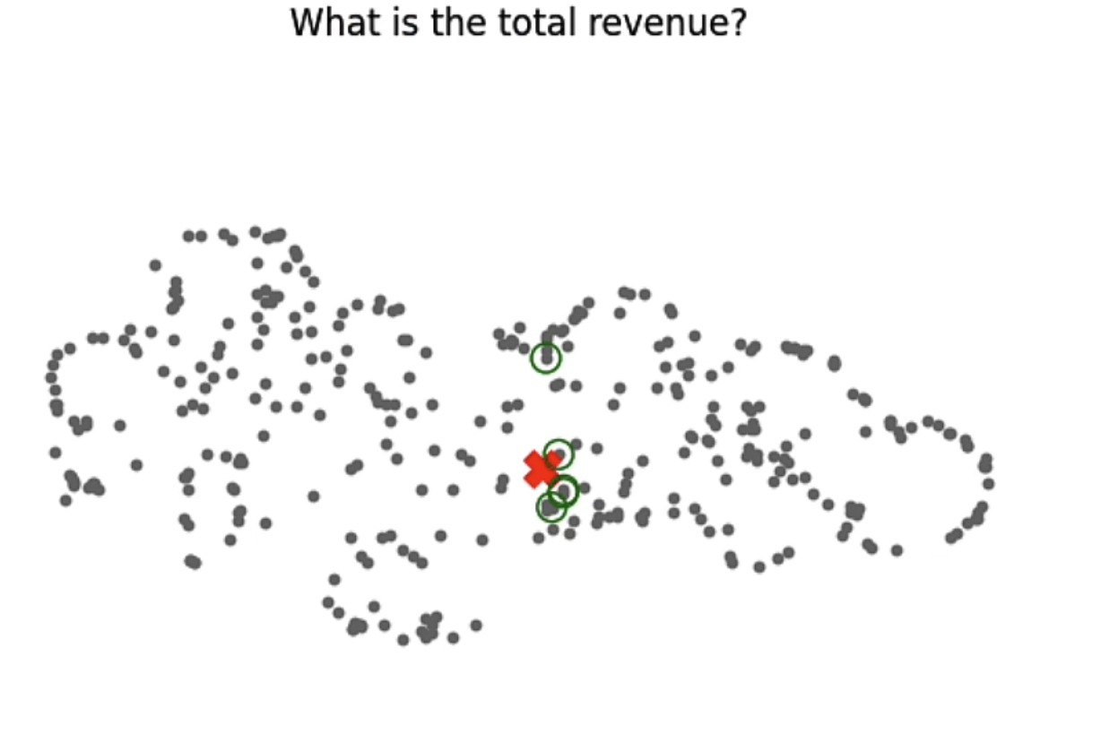
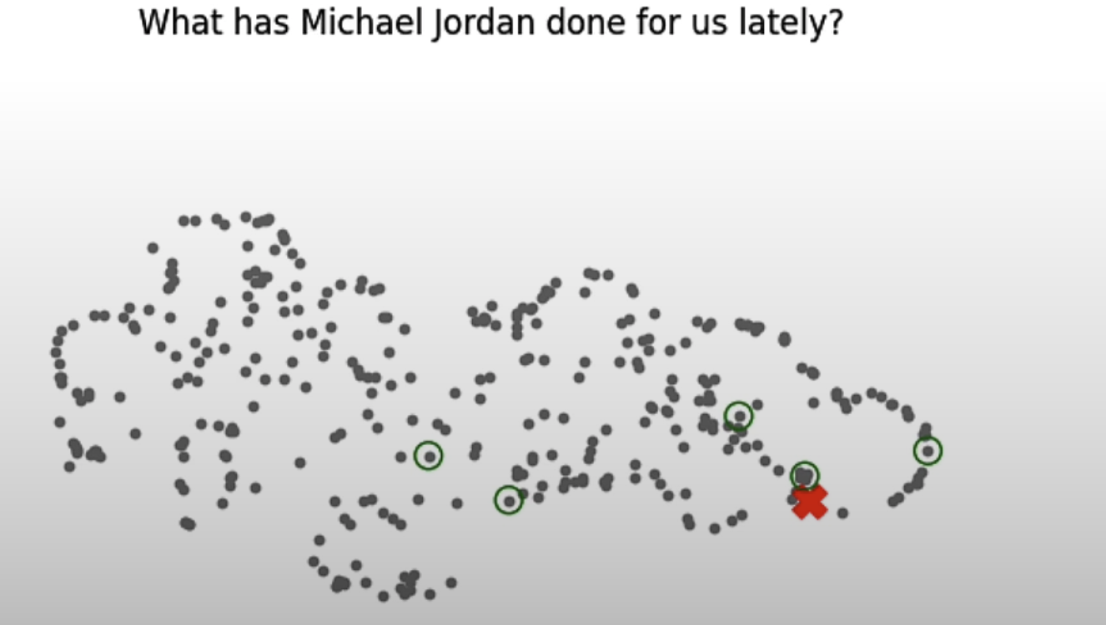
Retrieval – simple vector search

Slide 23
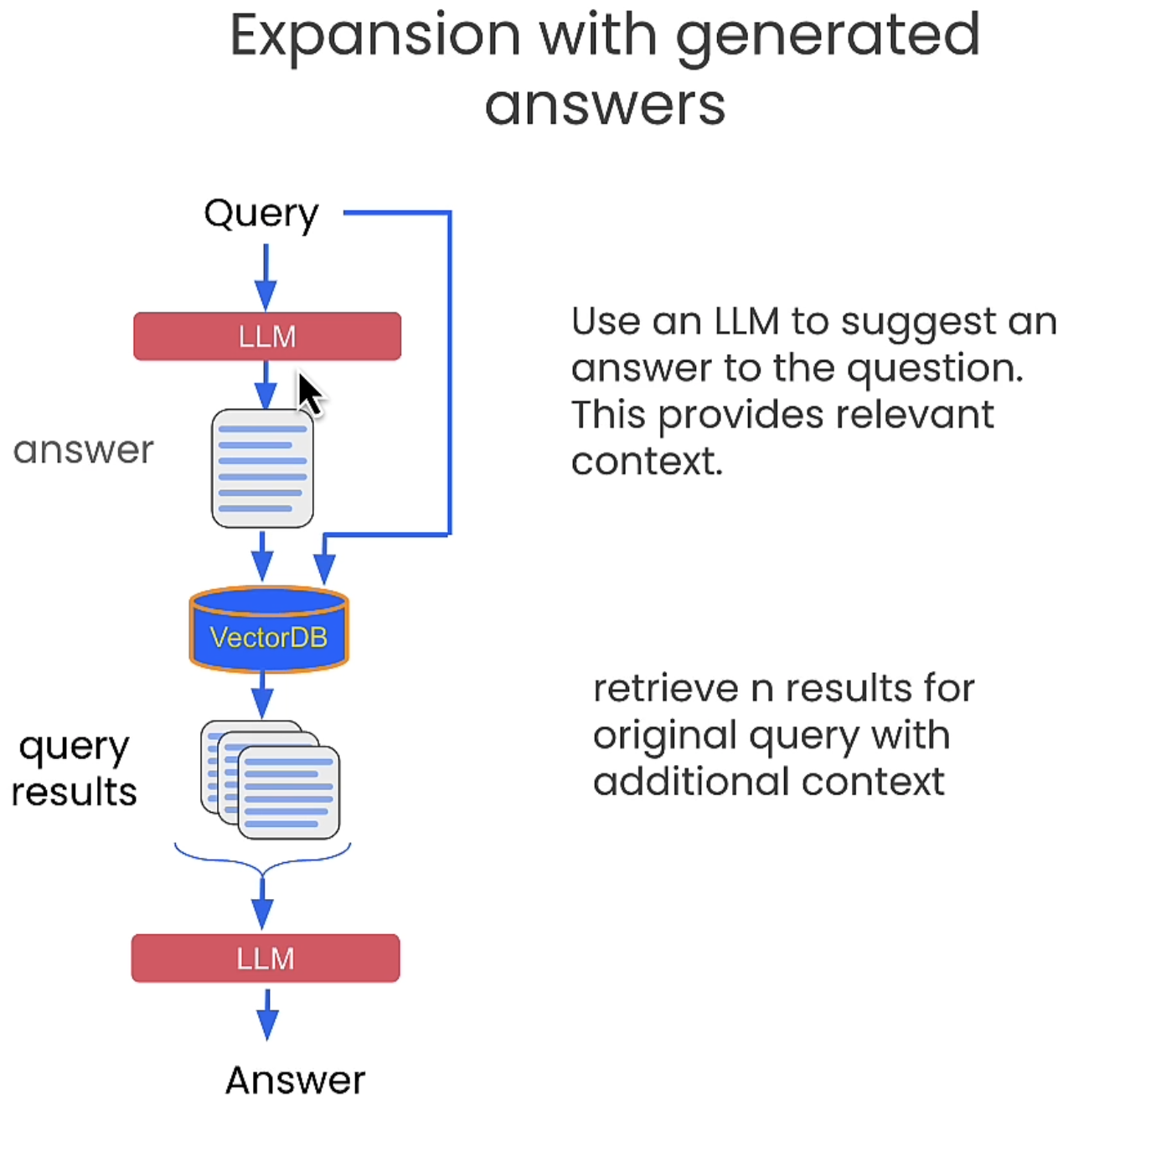
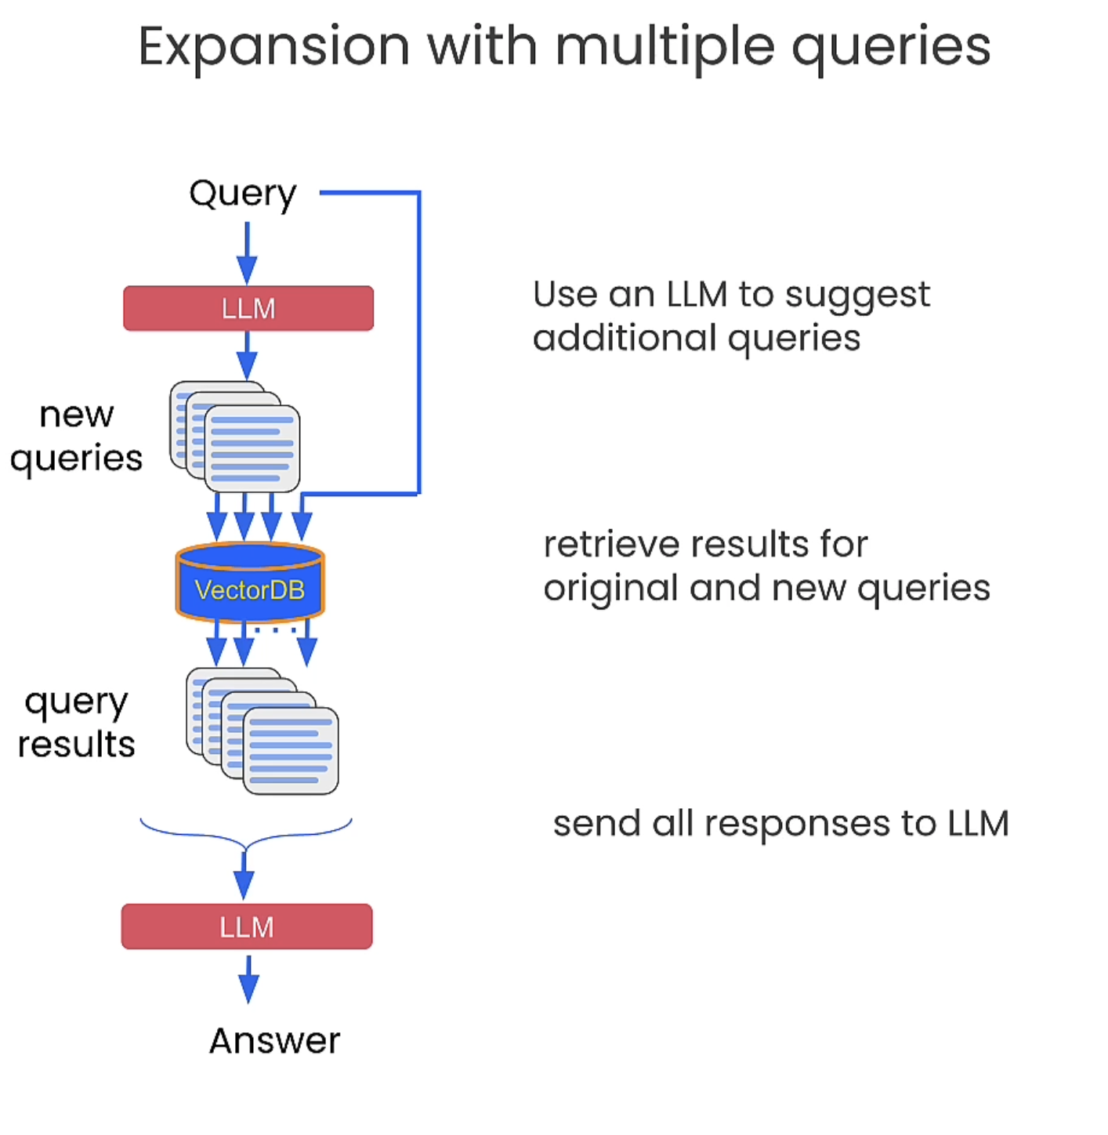
Improve Retrieval - Query Expansion

Slide 24
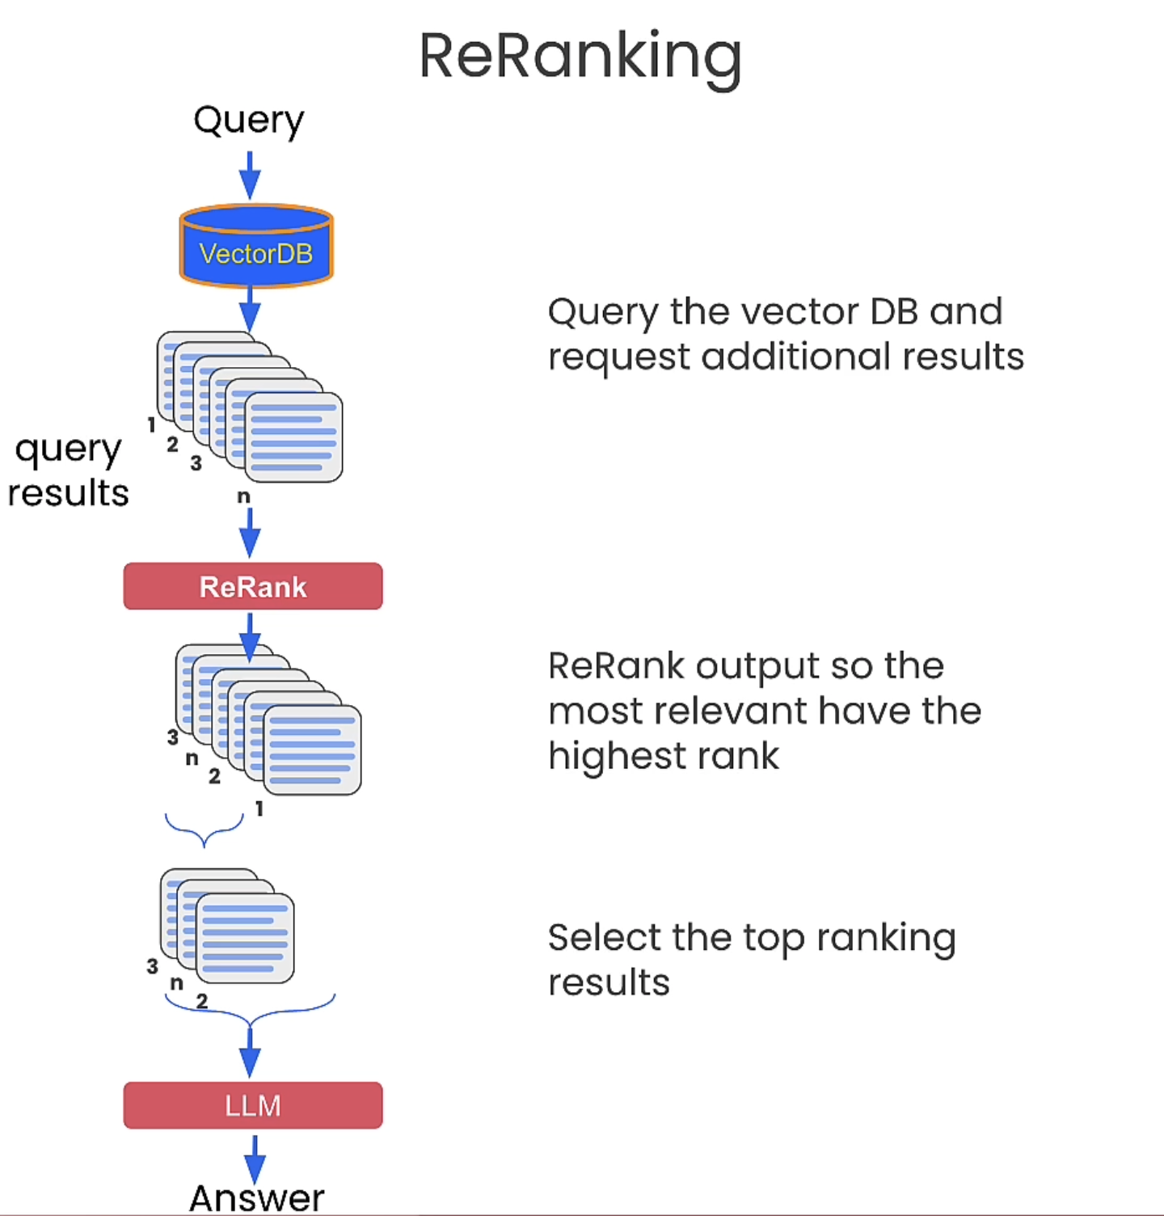
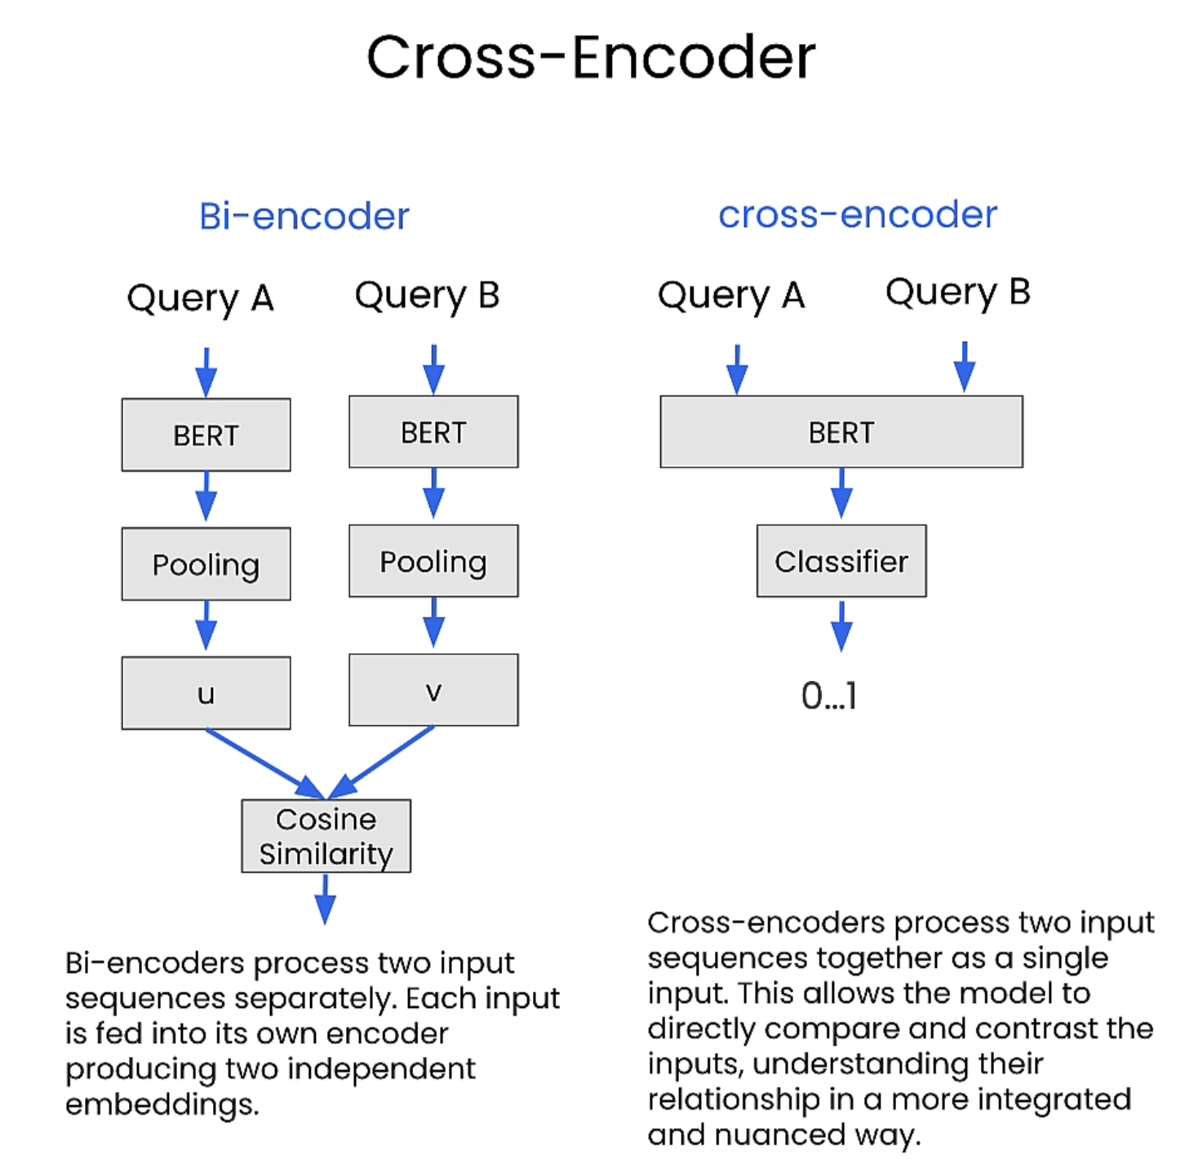
Cross-encoder re-ranking
Notes:
After feeding [CLS] Query A [SEP] Query B [SEP] through BERT, you get a contextual embedding for every token.
The [CLS] token’s embedding is special — BERT is trained so that this vector summarizes the meaning of the entire input pair.
This [CLS] embedding is essentially a high-level representation of the relationship between Query A and Query B.
[CLS] embedding → Linear layer → single number.
Apply sigmoid → a value between 0 and 1.
Interpret:
Close to 1 → Highly similar.
Close to 0 → Not similar.
relevancy score between 0 and 1

Slide 25
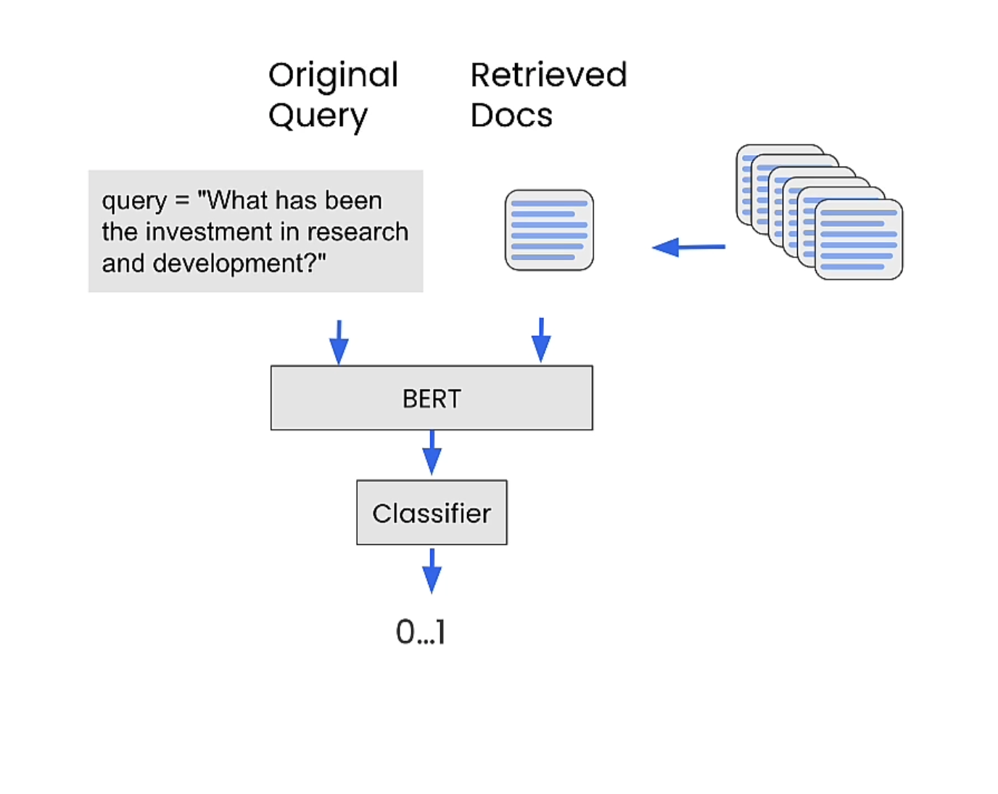
Cross-Encoder in Re-ranking

Slide 26
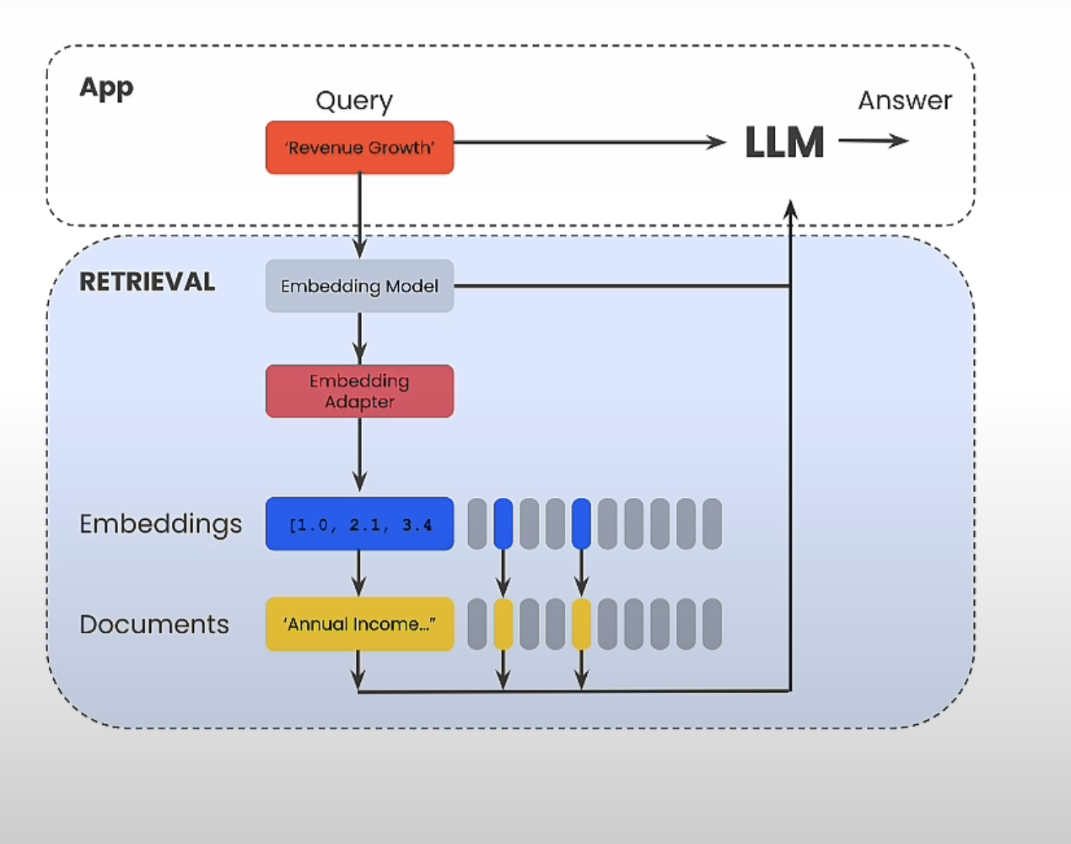
Embedding Adaptors
Notes:
Embedding Adaptors a way to alter the embedding vectors of a query directly to retrieve a better result
user gives feedback in form of label and embedding matrix is trained.

Slide 27
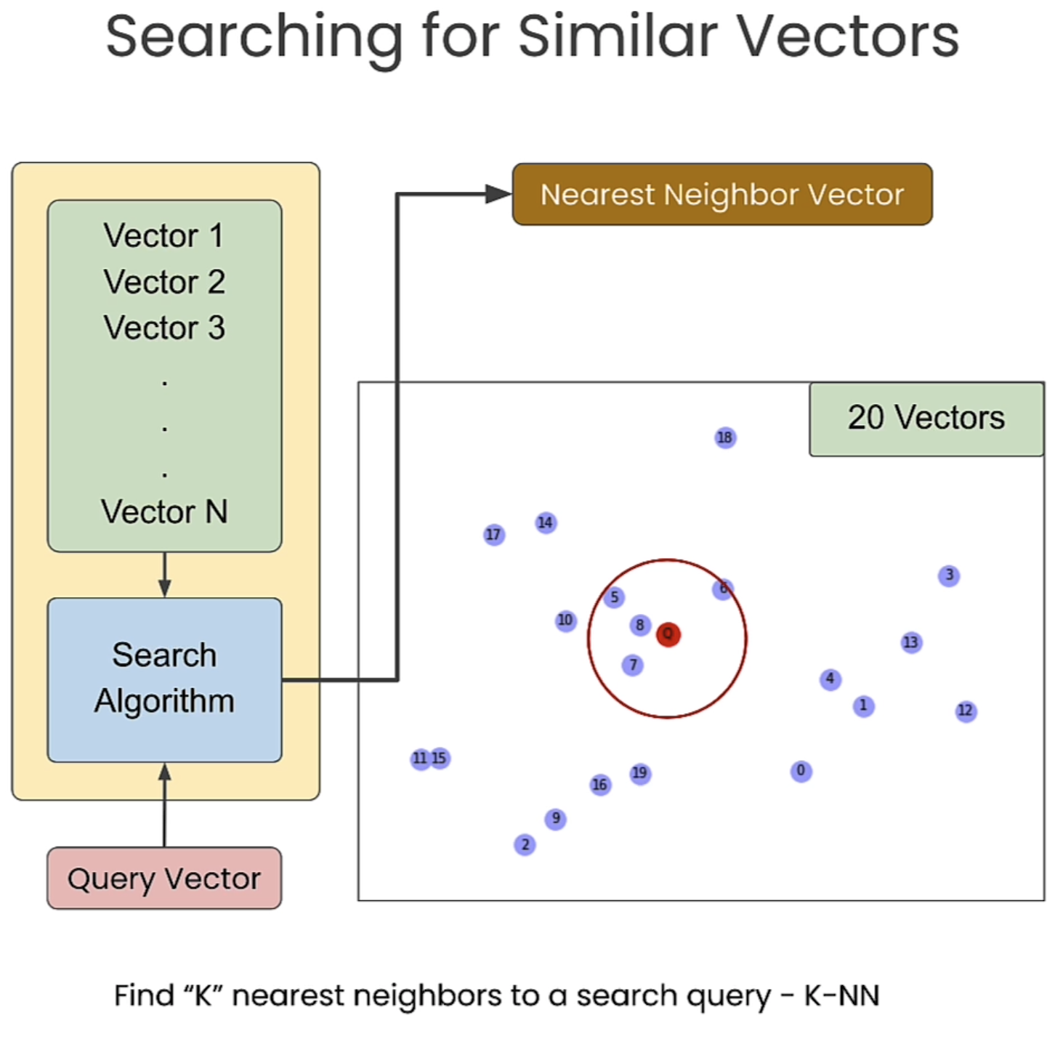
Vector Search
Notes:
dIS

Slide 28
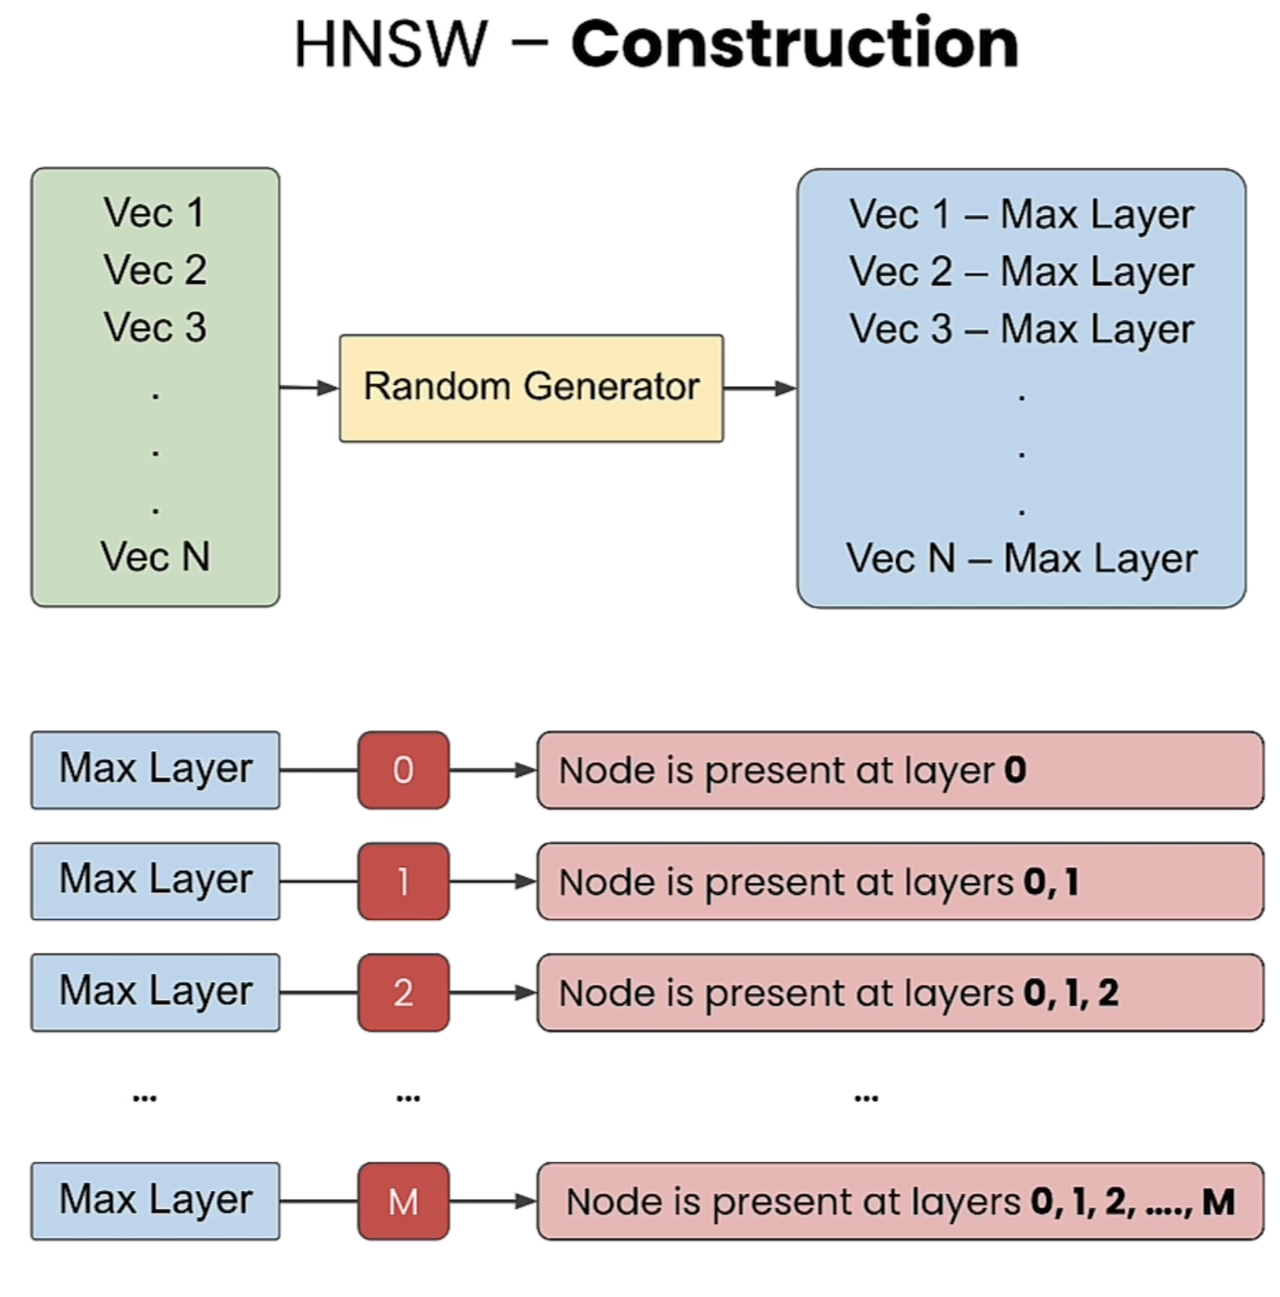
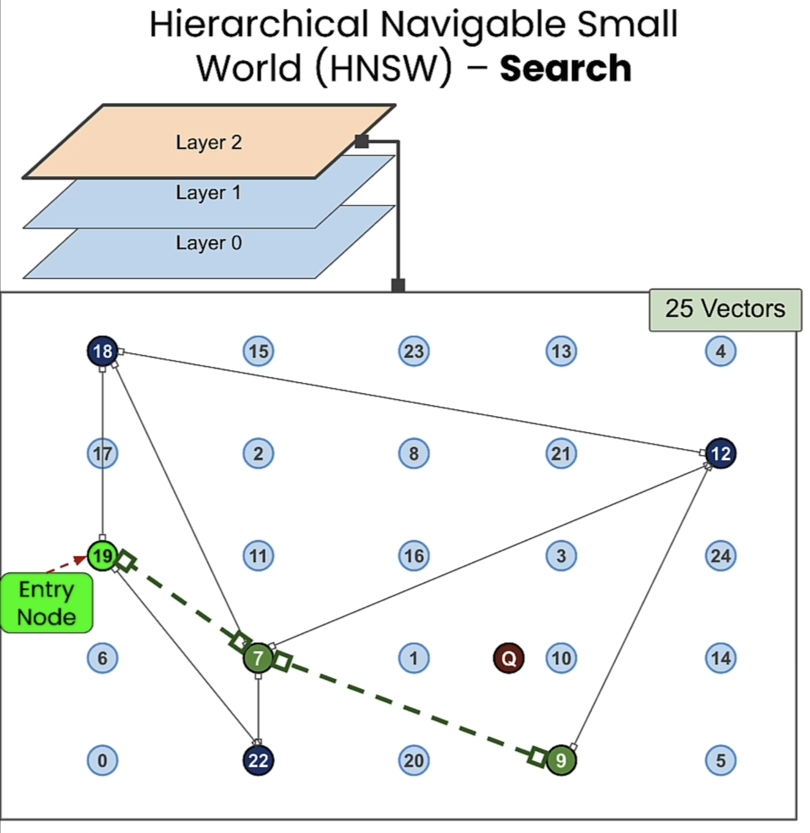
Approximate nearest neighbours - HNSW
Notes:
Top layers: Sparse, long-range connections (good for jumping far across the dataset).
Bottom layer: Dense local connections (good for precise nearest neighbor search).
Every point always appears in Layer 0 (the bottom layer).
When you insert a new point, you randomly decide its maximum layer LmaxL_{\text{max}}Lmax​ using an exponential distribution:
Most points will only be in Layer 0 or Layer 1.
Very few points will reach the top layers.
So the decision to move to the next layer is not dynamic — it’s literally: finish greedy search → drop one layer → repeat.

Slide 29
Sparse Search vs Dense Search
Dense Search ( Semantic Search )
Uses vector embedding representation of data to perform search.
This types of search allows one to capture and return semantically similar objects
query: Baby dogs
retrieval : Here is content on puppies!
challenge : a) Out of Domain data b) Product with a Serial Number
query : BB43300
retrieval: Bumble Bee?
Solution: Sparse Search ( Keyword Search )
Notes:
Searching for seemingly random data like serial numbers will also yield poor results

Slide 30
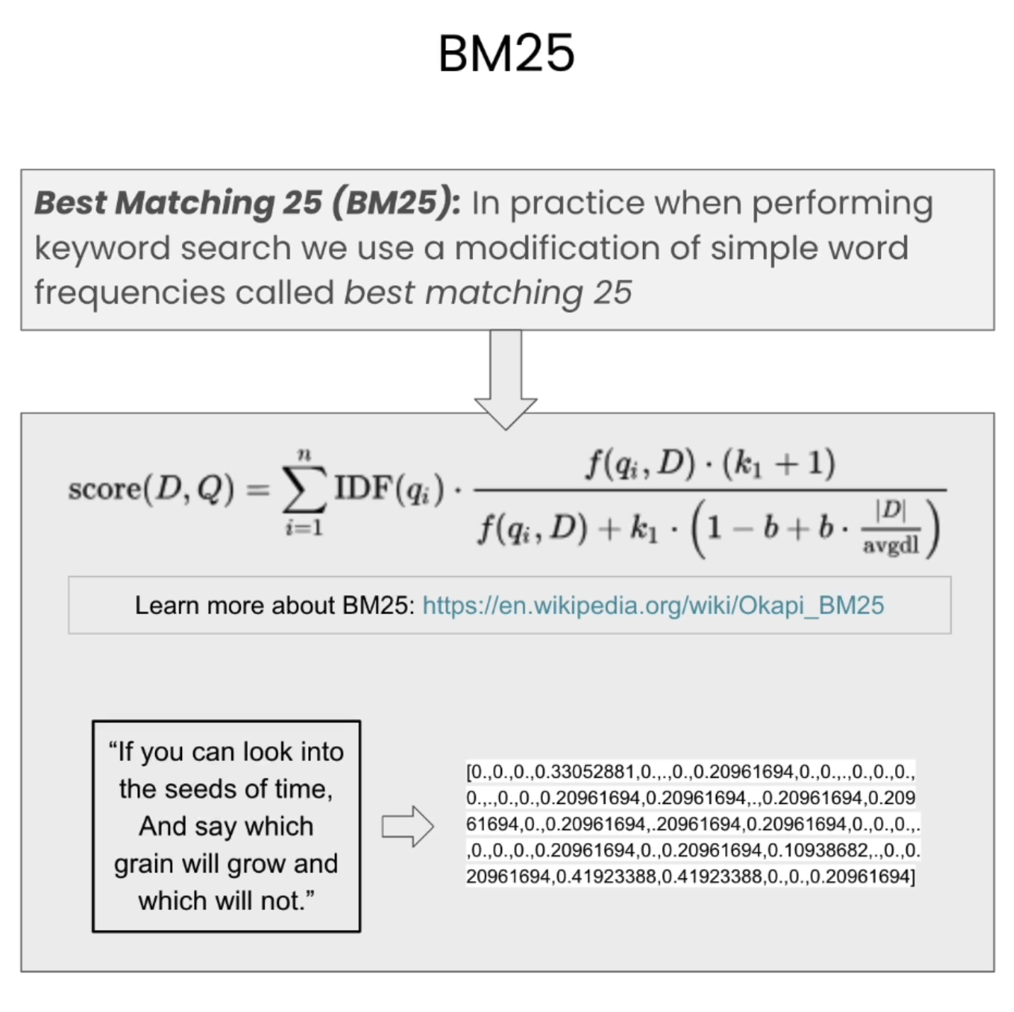
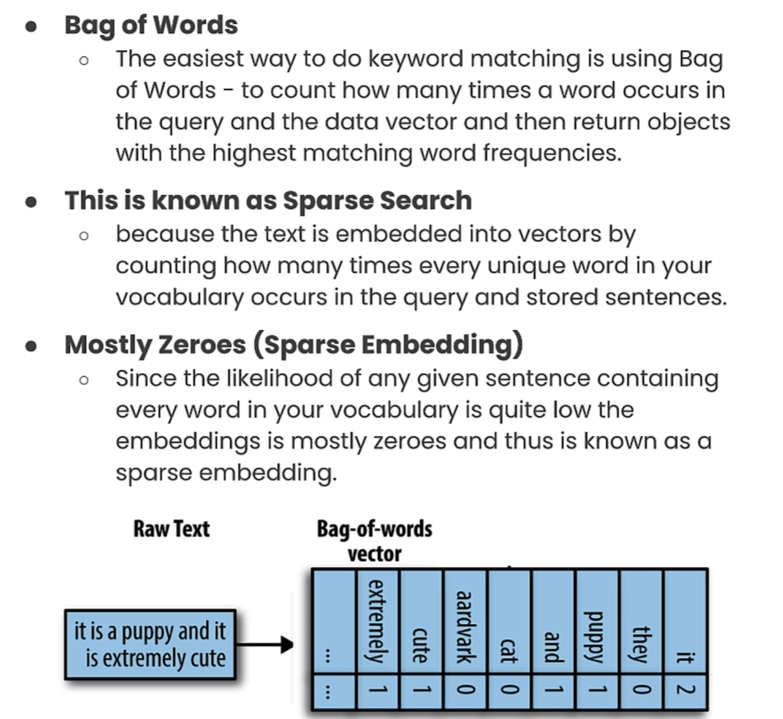
Sparse Search or Lexical Search
Notes:
BM25 (Best Matching 25) is a ranking function used in keyword search systems like Lucene, Elasticsearch, and Solr. It scores how relevant a document is to a text query based on term matches. It’s an improvement over simple TF-IDF by:
Adjusting for document length
Preventing term frequency from overpowering the score
Using parameters to tune behavior

Slide 31
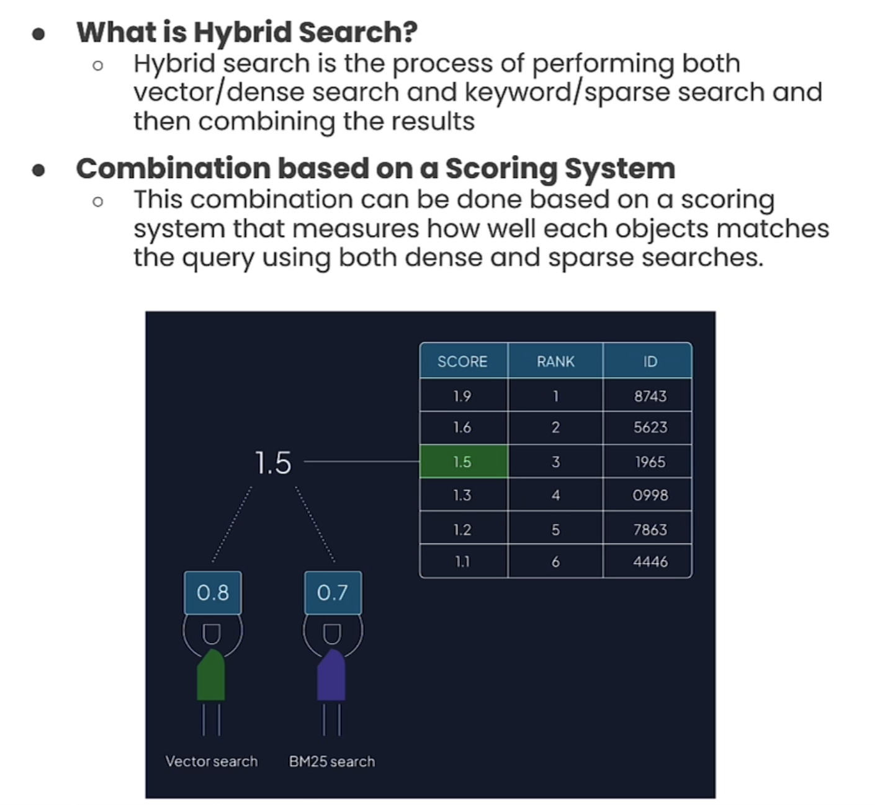
Hybrid Search

Slide 32
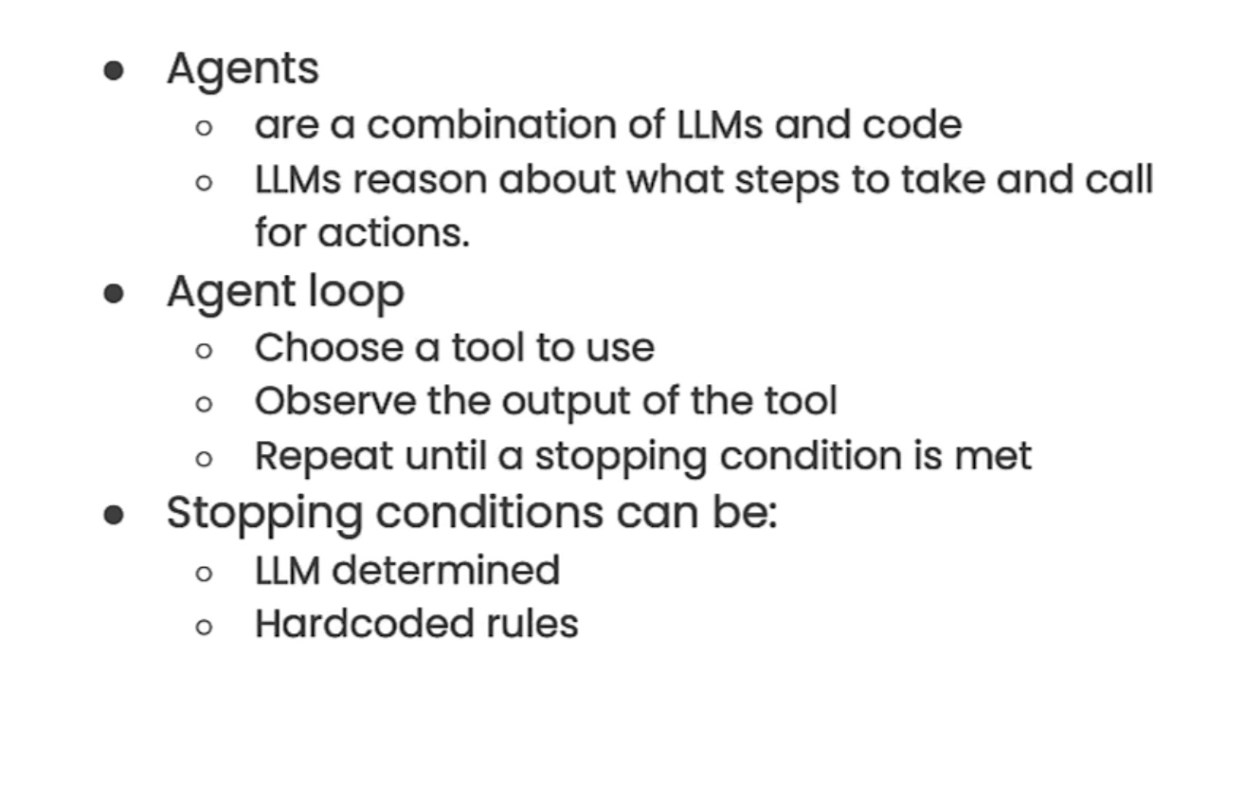
Agent Basics

Slide 33
Agent and Agent Loop Flow
1. User Input
Example: “ what is the weather in Zurich and tell me about the ZHAW?”
2. LLM ( Agent )
Analyzes request, Decides to use tools: - weather API – Wikipedia search
3. Tool Call #1 ( Framework like Lang Chain )
Runs weather API with city = ‘Zurich’
Gets: ‘Sunny, 27C’
4. Tool Call #2
Runs Wikipedia Search with query ZHAW
gets: ZHAW is Zurich University of Applied sciences
5. LLM Combines results
Merges weather + Wikipedia info into final answer

Slide 34
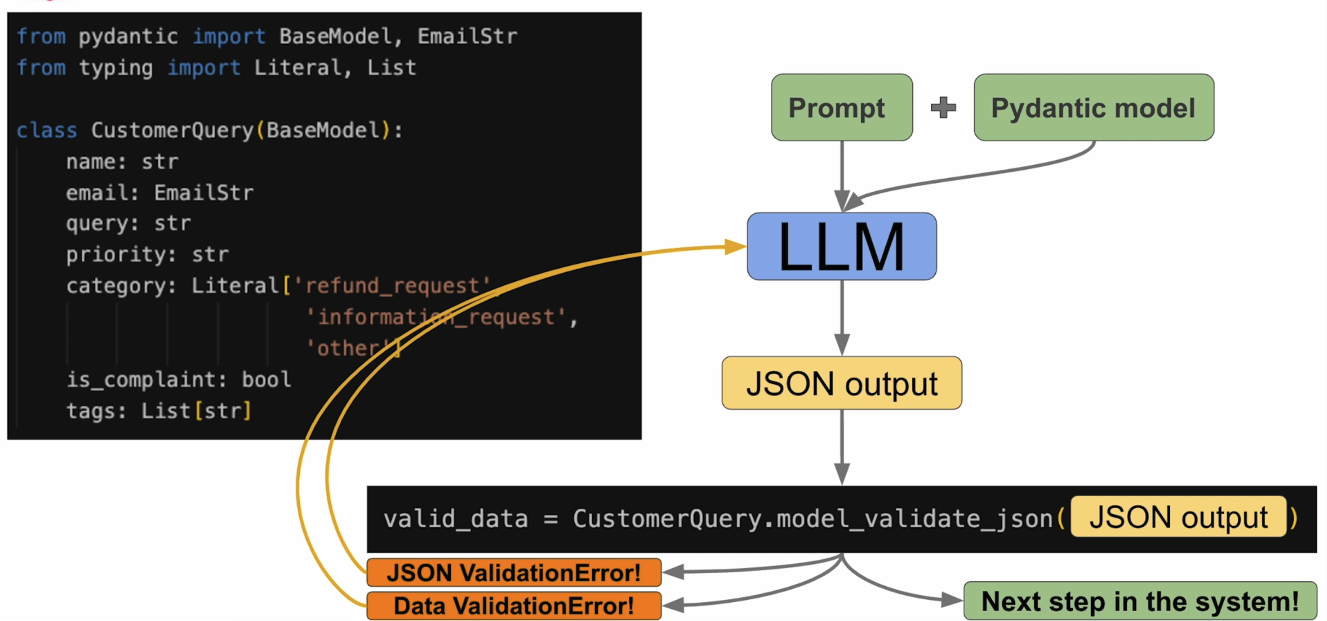
Structured Output
Notes:
pydantic is a data validation library for python. works with python type annotations. but rather than static type checking, they are actively used at runtime for data validation and conversion.
provides built in methods to serialize.deserialize models to/from json, dictionaries etc.
langchain leverages Pydantic to create JSON schema describing function.
Agents are a combination of LLMs and Code. LLM reason about what steps to take and call for actions.

Slide 35
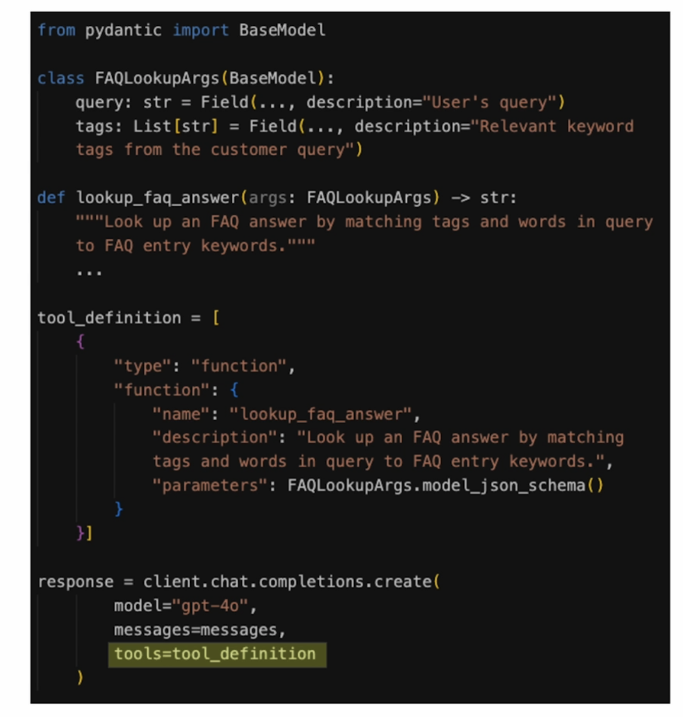
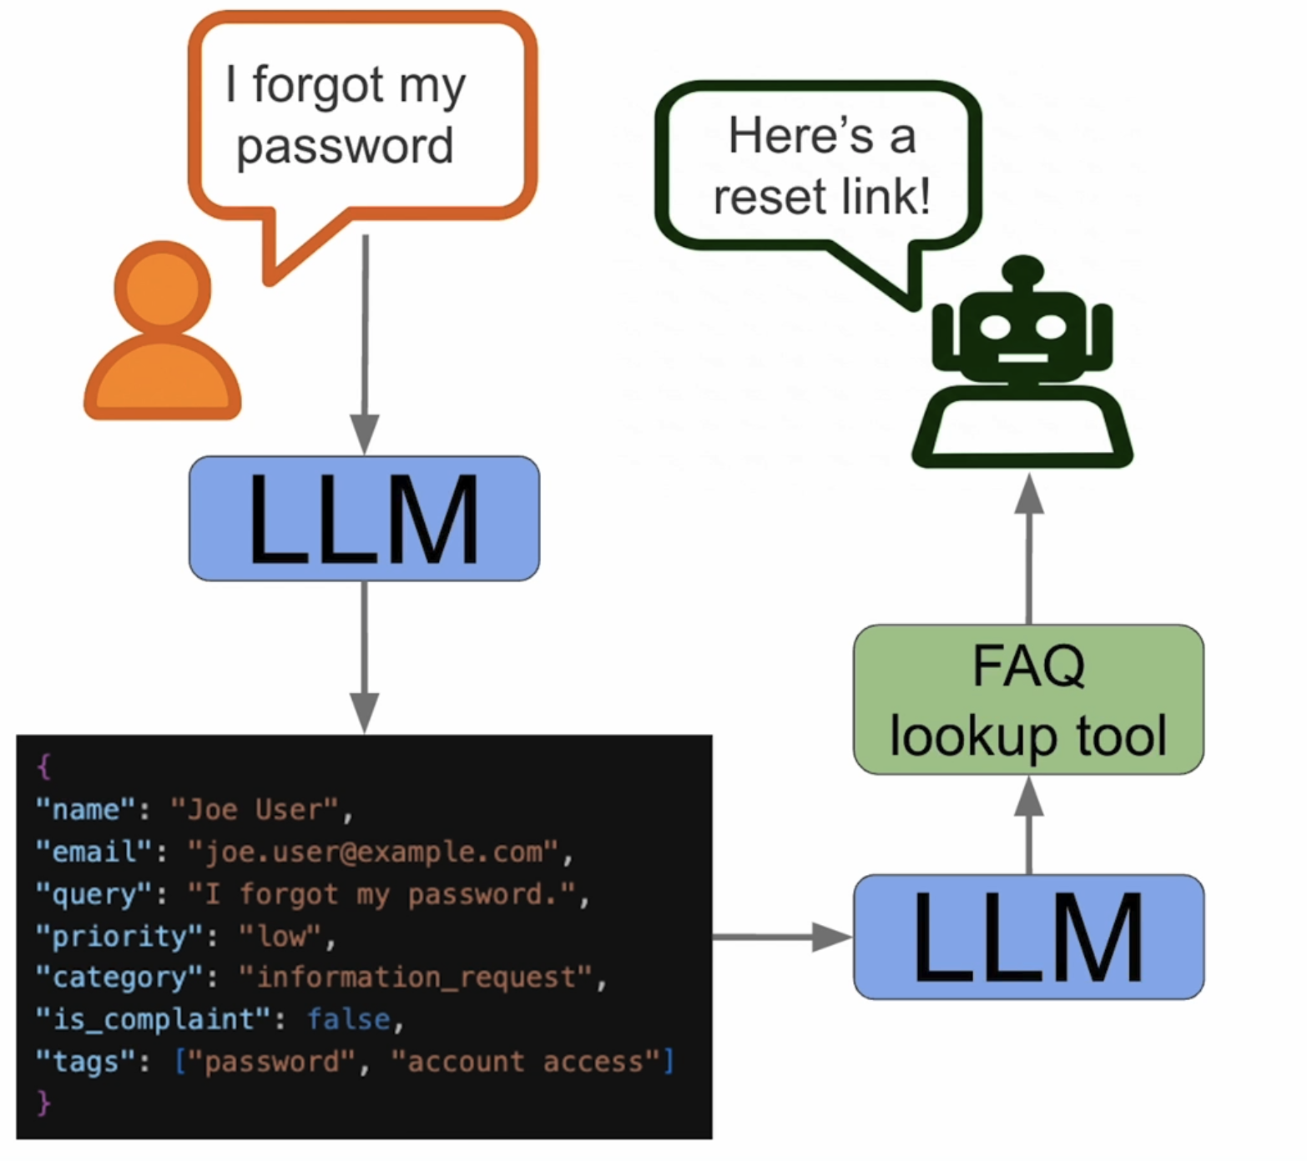
Tool calling
Notes:
User Input
”what’s the weather in Zurich tomorrow?”
LLM Model
Recognizes pattern -> select ‘weather tool’
Output JSON request
Orchestrator / Application Layer. ( LangChain )
Parses LLM output, validates tool call, executes API request
Tool Execution
Weather API responds -> ‘Sunny, 27C’
Back to LLM
Receives tool output
Generates final answer: ‘it will be sunny and 27C in Zurich tomorrow.’

Slide 36
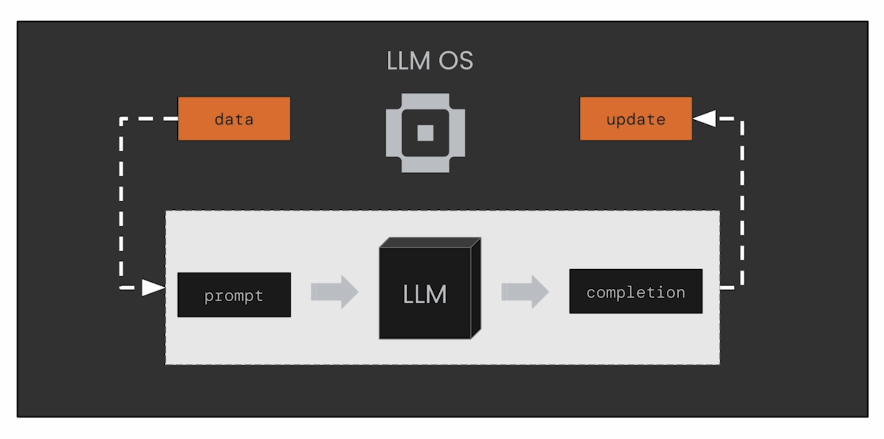
LLMs as Operating Systems: Agent Memory ( MemGPT )

Slide 37
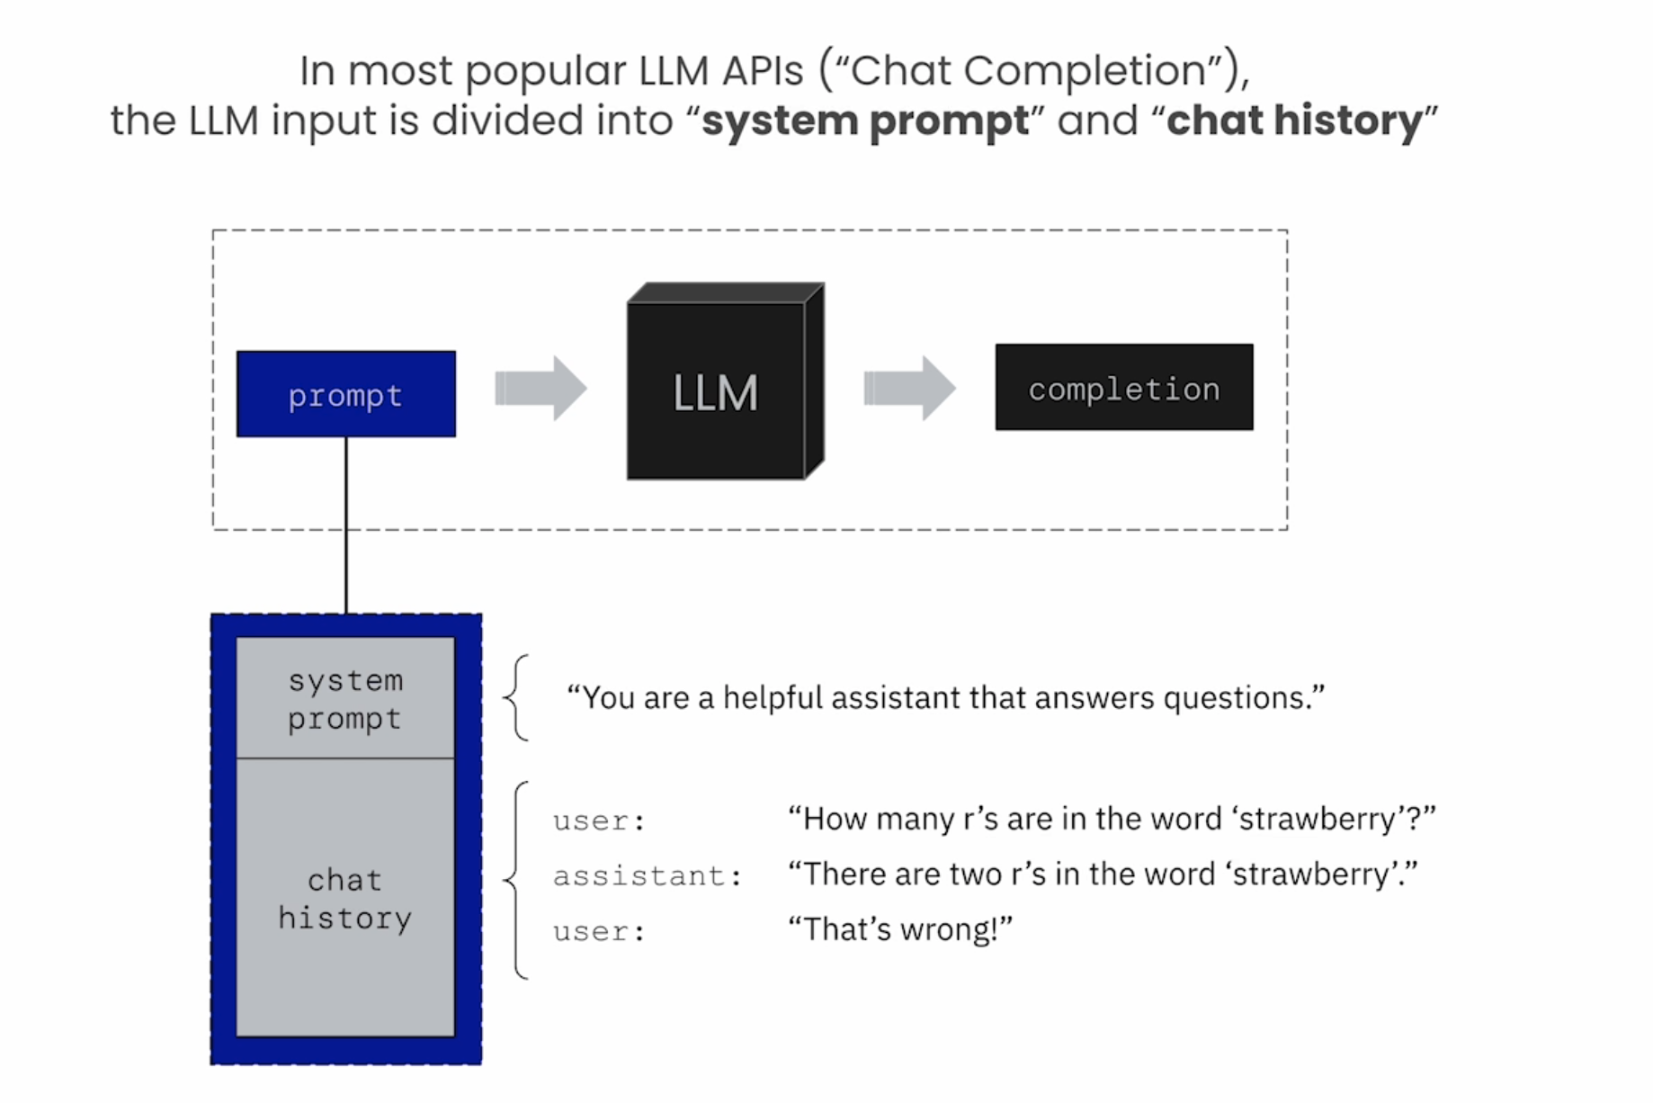
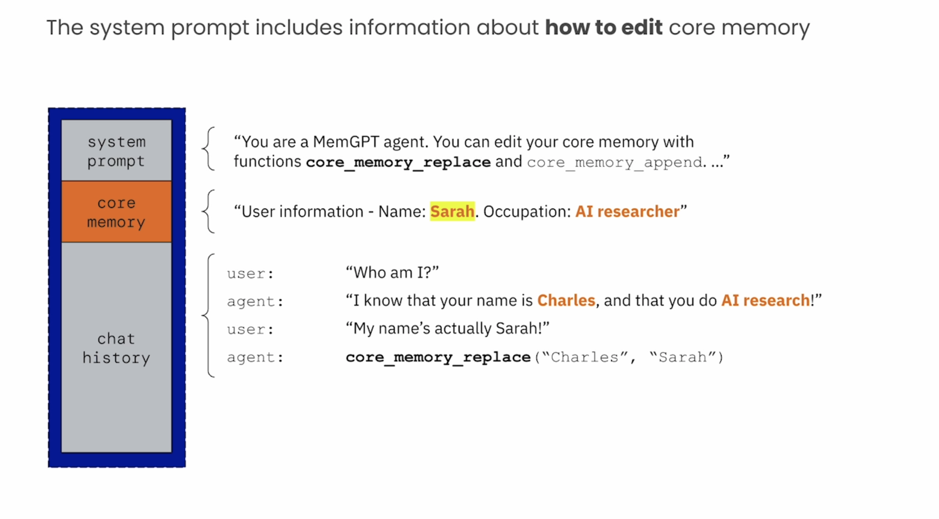
Breaking down the context window core memory allows the MemGPT agent to learn over time

Slide 38
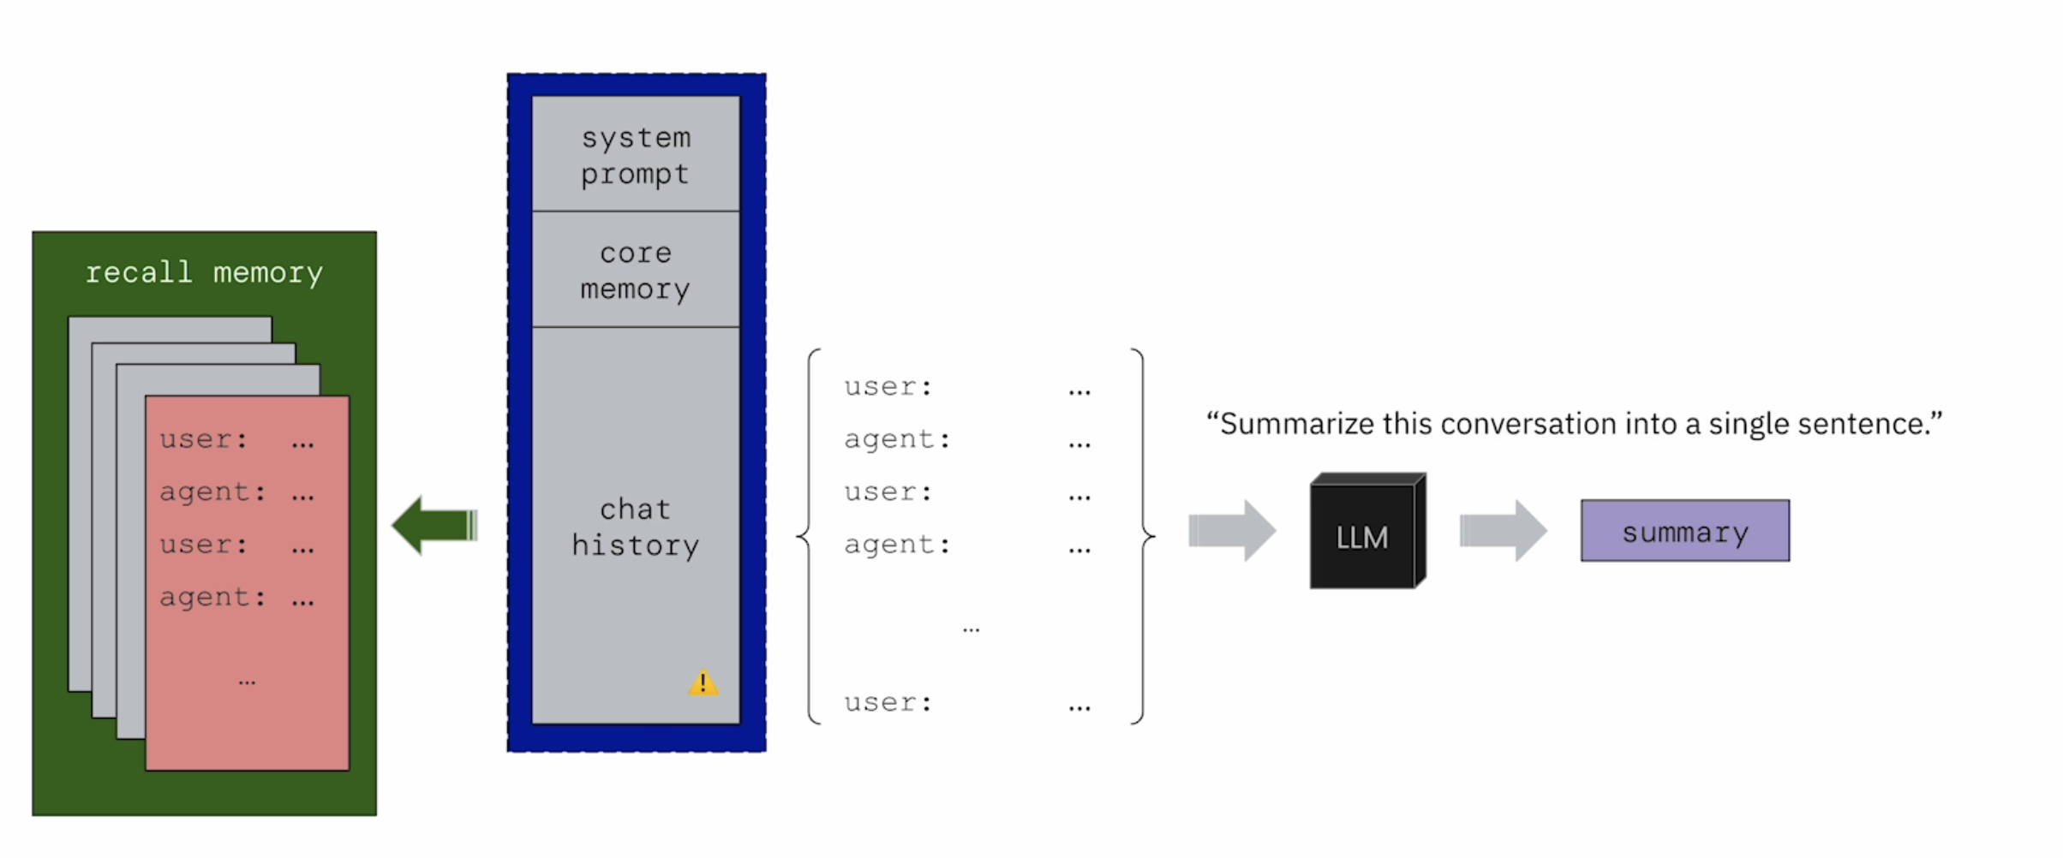
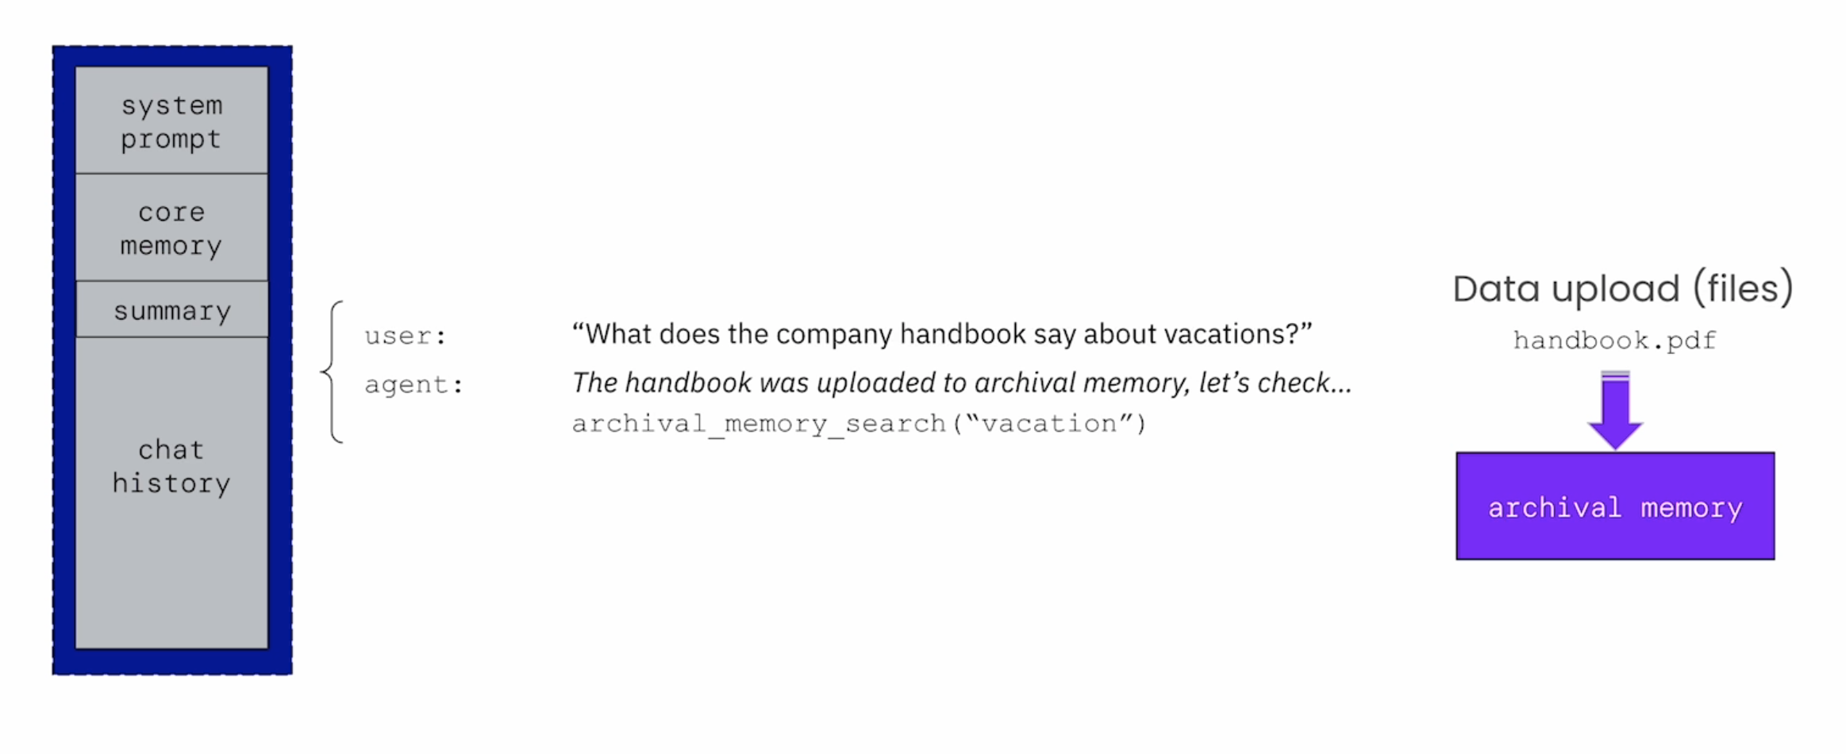
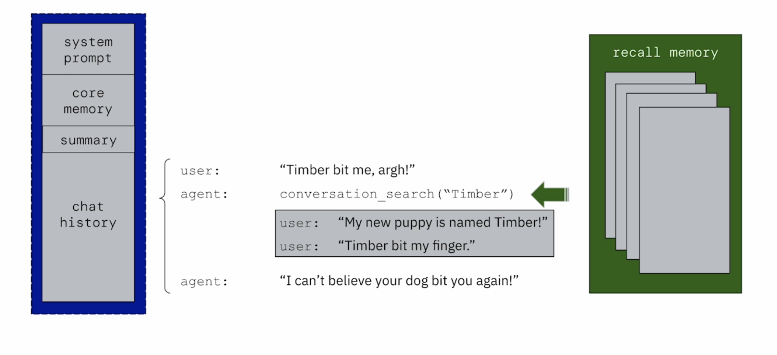
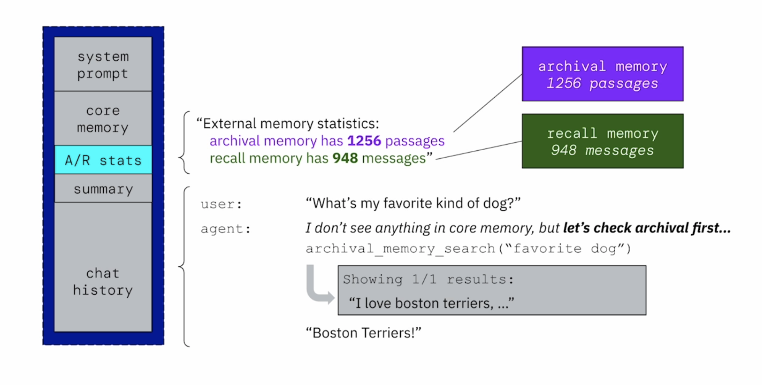
Breaking down the context window
Notes:
when we run out of space: summarize and flush ( evict ) memory. we store the evicted messages inside on disk ( an unlimited data store ). if the agent needs access to old messages, it can search recall storage.
core memory is also limited in size.
MemGPT agents have a second tier of memory: archival memory.
MemGPT agents can use archival memory as a general data store ( RAG )

Slide 39
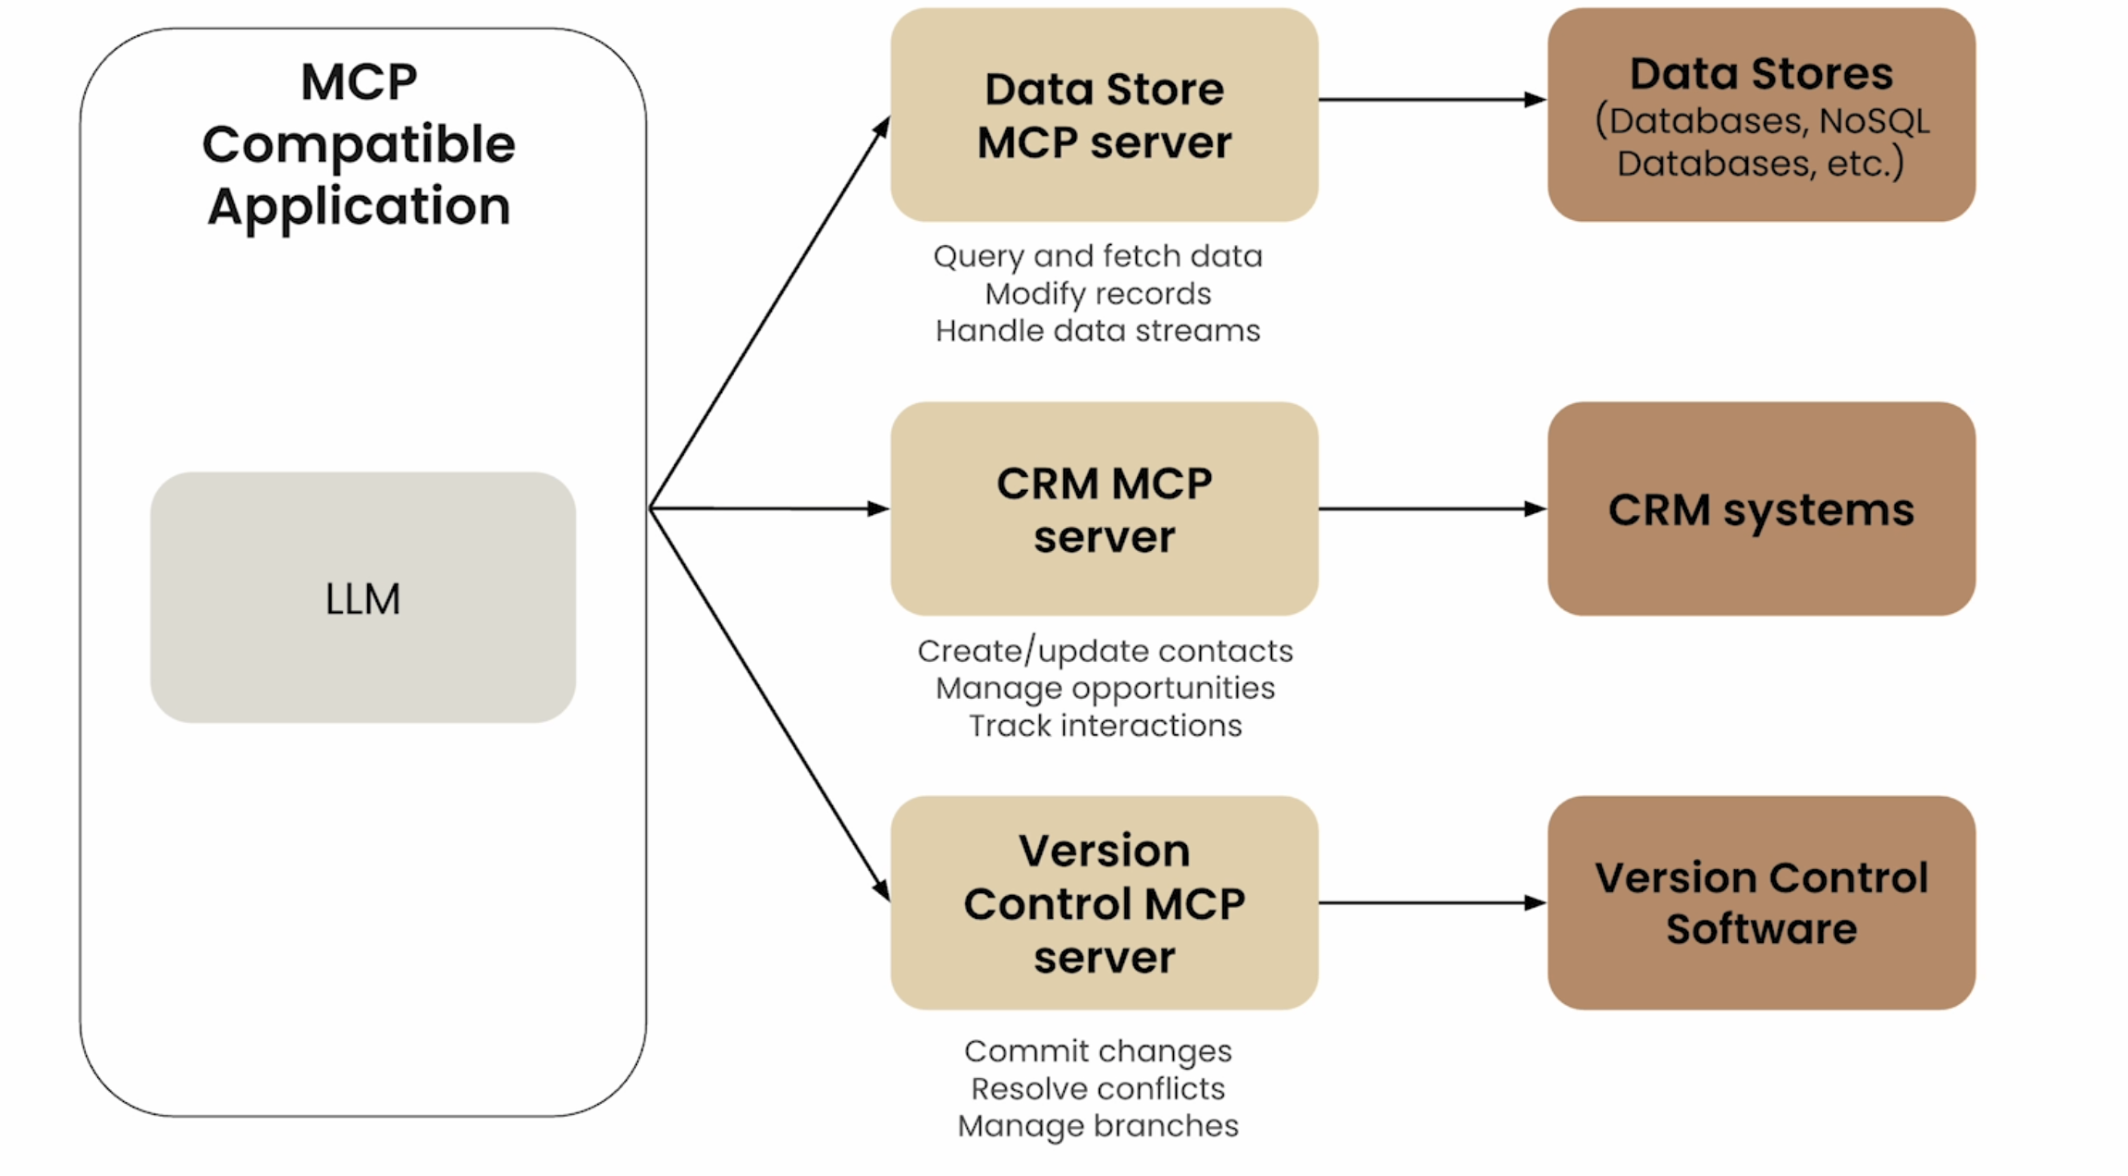
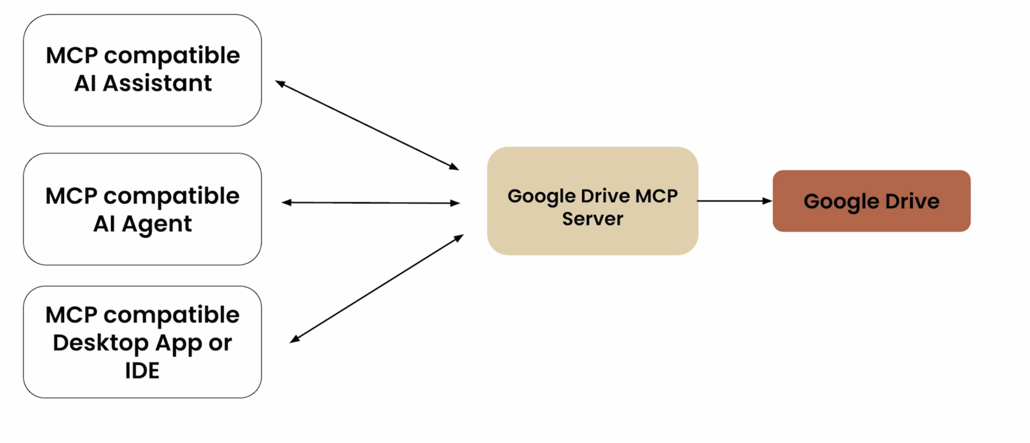
MCP – Model Context Protocol
MCP is an open protocol that standardizes how LLM applications connect to and work with tools and data sources.
Notes:
Models are only as good as the context given to them.
with MCP: Standardized AI development. MCP servers are reusable by various AI applications.
for AI application developers: connect your app to any MCP server with 0 addition work.
for tool or API developers: Build an MCP server once which can be adopted everywhere.
for AI application users : AI applications have extensive capabilities
for enterprises: clear separation of concerns between AI product teams
MCP servers provide tool schemas + functions already defined for you. MCP servers provide tool schemas + functions. service provider will make their own MCP implementation.

Slide 40
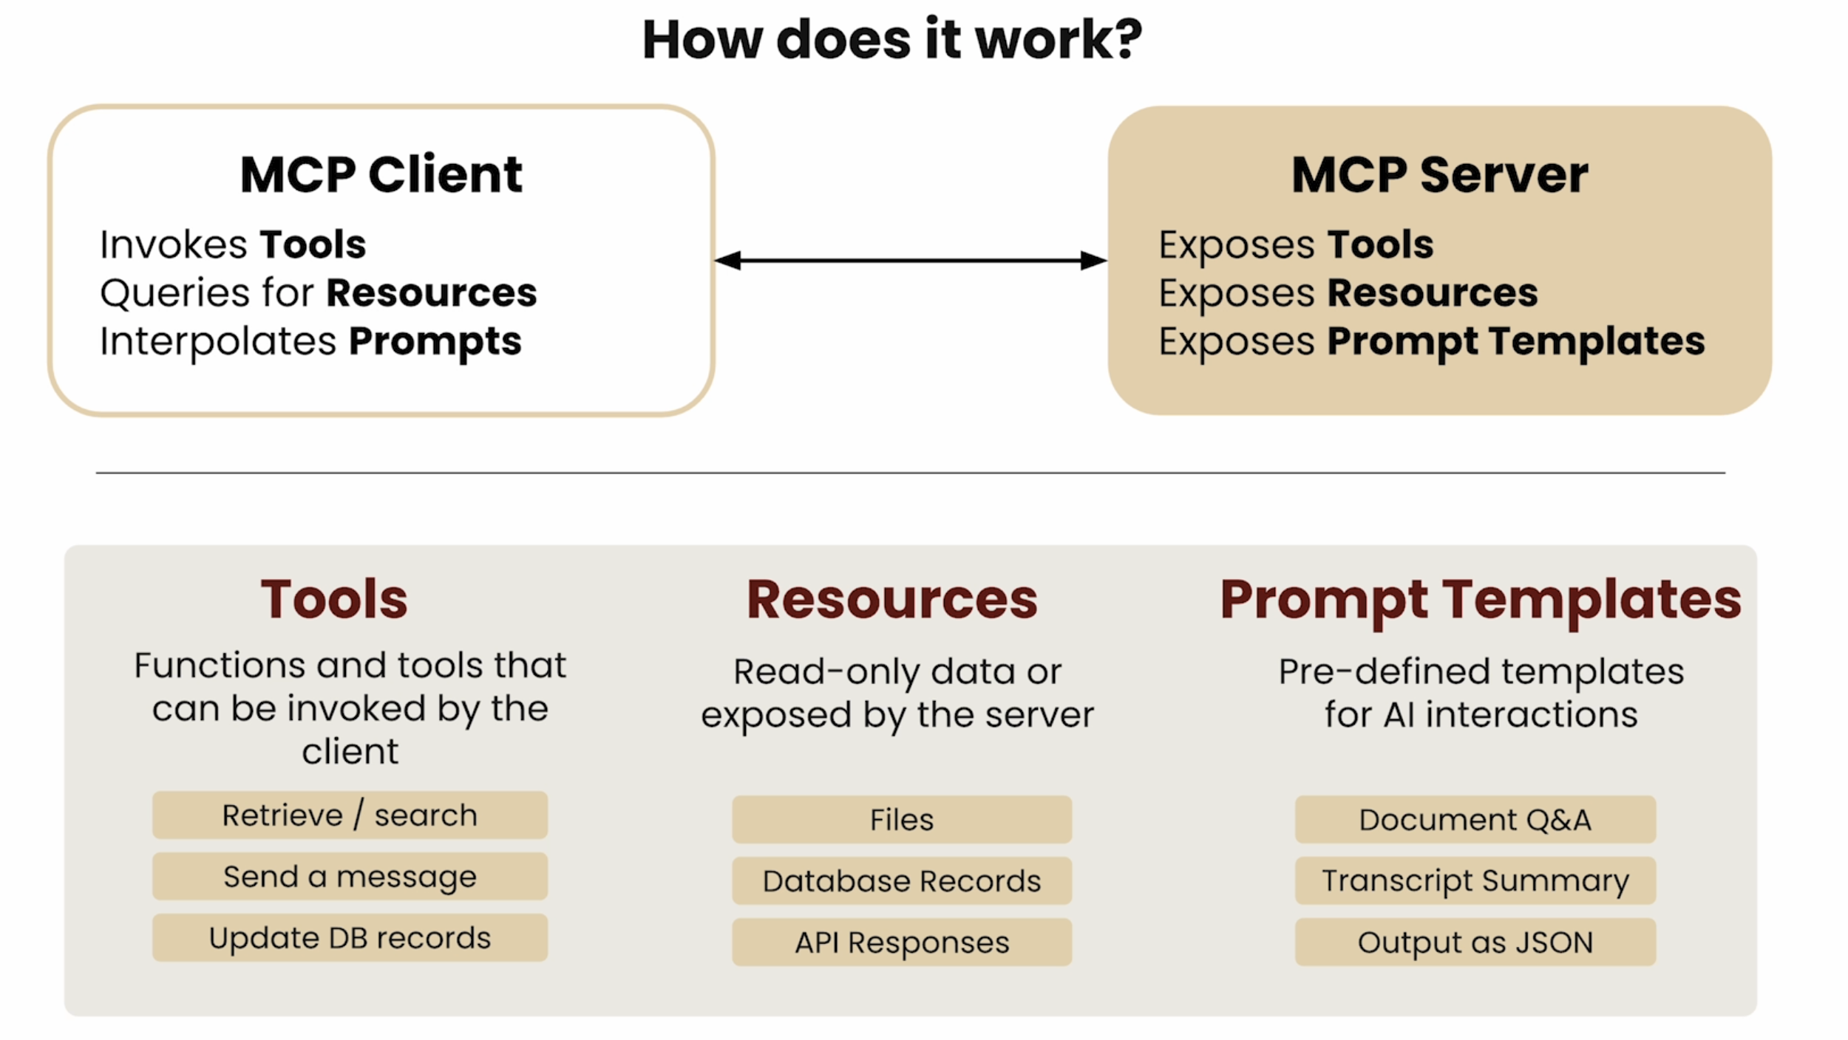
MCP

Slide 41
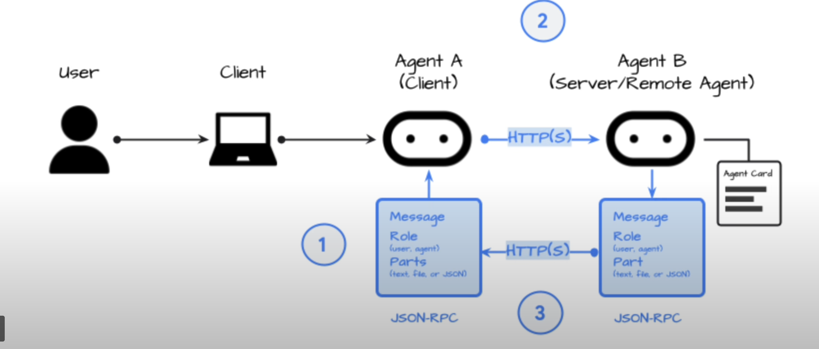
A2A : Agent2Agent Protocol
Standardizes communication between autonomous AI agents
It aims to connect the ecosystem of stand-alone agents so they can collaborate

Slide 42
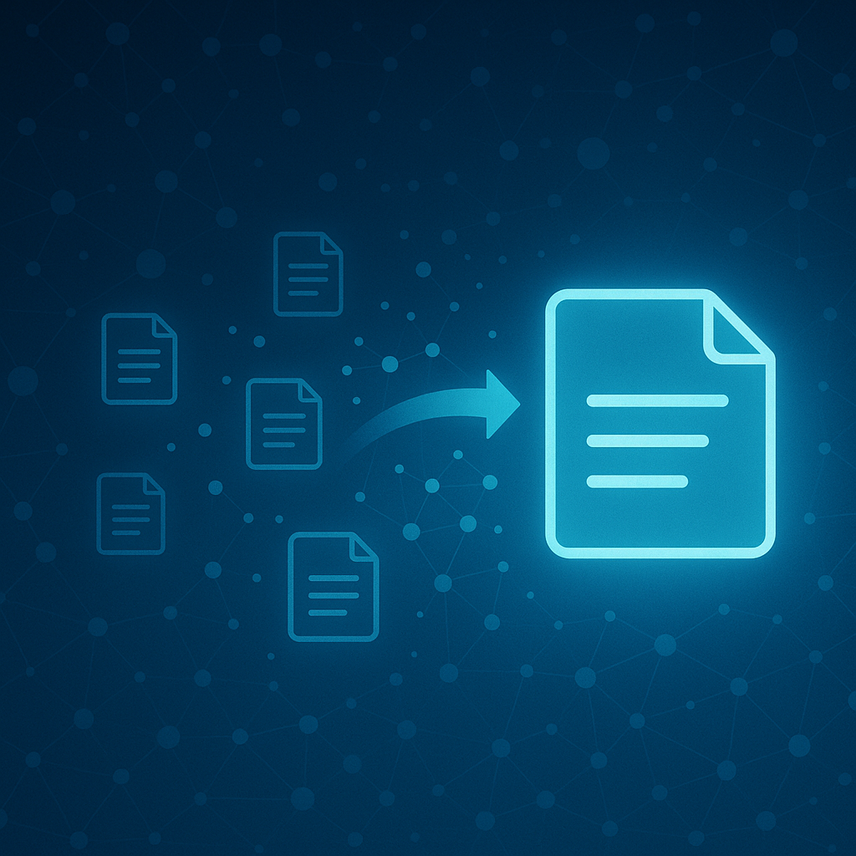
RAG
Demo

Slide 43
references
References & Acknowledgements
This presentation draws upon materials and insights from the following excellent resources:
DeepLearning.AI: Visuals and core concepts from their LLM courses.
Andrej Karpathy: Technical insights and examples from his YouTube series.
Disclaimer: These materials are used solely for educational, non-commercial purposes. While every effort has been made to attribute content correctly, any unintentional omissions are regretted. If you are a copyright holder and have concerns about specific usage, please notify me, and I will be happy to address them immediately.

